Slide 1
Law Enforcement Mutual Aid Trauma Program Overview
Region 5 EMS Advisory Council and
Region 5 Regional Trauma Advisory Committee
Regional Trauma System Improvement
Grant Project

Slide 2
Program Outline
Mutual Aid Trauma Program Highlights
Overview of Trauma Kit Components
Medical Response to Trauma: The Hartford Consensus
Bleeding Control for the Injured
Establishing Care Priorities

Slide 3
Purpose
The Law Enforcement Mutual Aid Trauma Program is designed to enable law enforcement personnel acting in accordance with Georgia’s Good Samaritan Statue (51-1-29 to 51-1-29.3) to render immediate, potentially life-saving medical aid to the injured while they await the arrival of emergency medical services.

Slide 4
Program Highlights
The Law Enforcement Mutual Aid Trauma Program is a public health/emergency preparedness initiative being jointly administered by the Region 5 EMS Advisory Council and the Region 5 Regional Trauma Advisory Committee (RTAC).
Program materials are provided through funding from the Georgia Trauma Care Network Commission.

Slide 5
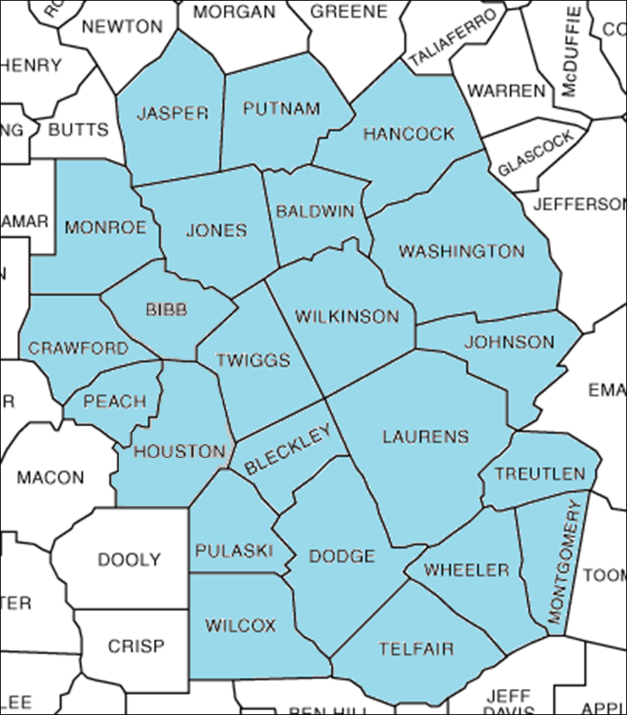
Program Highlights
Currently, rural law enforcement agencies in the counties served by EMS Region 5 are eligible participate in the Mutual Aid Trauma Program.

Slide 6
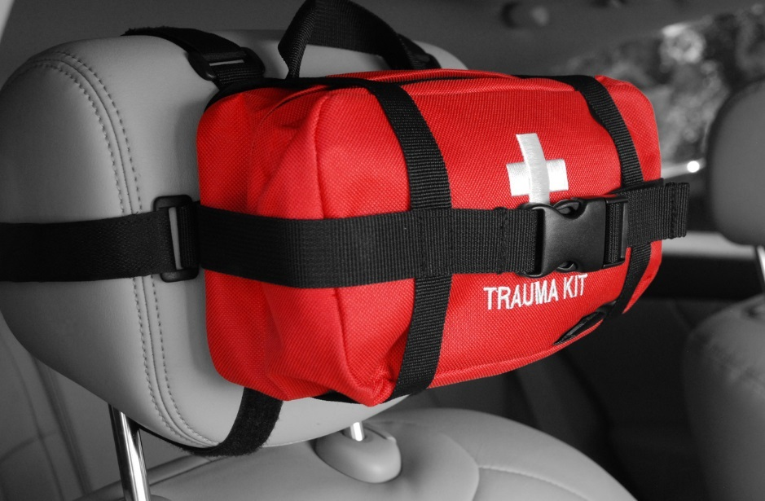
Program Highlights
Participating agencies are issued Mutual Aid Trauma (MAT) Kits
Kit recipients are required to receive training in the use of the kit's contents, basic management of airway and breathing and hemorrhage control.

Slide 7
Kit Components
C-A-T Tourniquet
Compressed Gauze (x2)
Hyfin Chest Seal, Twin Pack
4” Trauma Dressing
Trauma Shears
5”x9” Trauma Pad
Nitrile Gloves (2 pair)
CPR Face Shield
Instruction Card

Slide 8
Item Replacement
If this kit is used in an incident, please report the incident to the appropriate Department personnel, then contact the Region 5 Regional EMS Director, Kelly Joiner, at 478-993-4990 or kelly.joiner@dph.ga.gov.
Rescue Essentials will replace any components used in the incident at no charge to you or your department in exchange for incident details.
Use the MAT Kit Supply Replacement Form.
All information remains confidential.

Slide 9
HARTFORD CONSENSUS
The Joint Committee to Increase Survival from Active Shooter and Intentional Mass Casualty Events
Recommendations represent the consensus opinion of a multi-disciplinary committee involving medical groups, the military, the National Security Council, Homeland Security, the FBI, law enforcement, fire rescue, and EMS
These recommendations have become known as the Hartford Consensus
Notes:
The Joint Committee to Increase Survival from Active Shooter and Intentional Mass Casualty Events was convened by the American College of Surgeons in response to the growing number and severity of these events. The committee met in Hartford Connecticut and has produced a number of documents with recommendations. The documents represent the consensus opinion of a multi-disciplinary committee involving medical groups, the military, the National Security Council, Homeland Security, the FBI, law enforcement, fire rescue, and EMS. These recommendations have become known as the Hartford Consensus

Slide 10
HARTFORD CONSENSUS
Discussed active shooter/blast events
Problem: Long-standing practices for law enforcement, fire/rescue, and EMS responses are not optimal to maximize victim survival
Goal: Develop recommendations and policies to enhance the survival of victims of these events

Slide 11
HARTFORD CONSENSUS
There must be a continuum of care that begins with the initial responders and continues to definitive care.
Care of the victims is a shared responsibility between immediate responders (the public), law enforcement, fire/rescue, and EMS.
Notes:
There must be a continuum of care that begins with the initial responders and continues to definitive care.
Care of the victims is a shared responsibility between, immediate responders law enforcement, fire/rescue, and EMS.
Optimal outcome depends on communication between all public safety responders
The response requires coordination between law enforcement and the medical/evacuation providers
Such coordination includes jointly developed protocols for an integrated response to these events

Slide 12
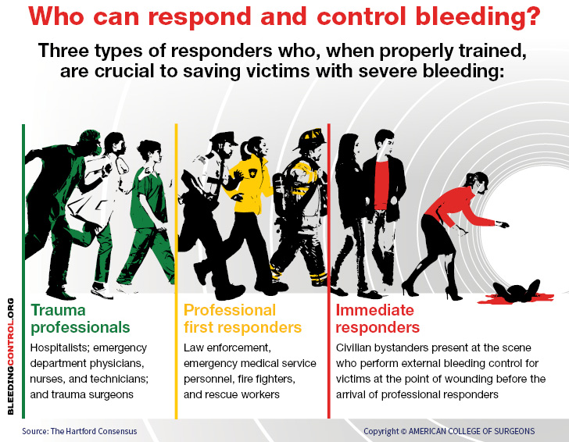
Notes:
There must be a continuum of care that begins with the initial responders and continues to definitive care.
Provide a seamless integration of bleeding control interventions
General public
Responding officer
EMS/fire/rescue
Definitive trauma care
EMS/fire/rescue must be involved earlier in the care of the victims

Slide 13
HARTFORD CONSENSUS
Fundamental Concept
No one should die from
uncontrolled bleeding.
Notes:
No one should die from uncontrolled bleeding.
The overarching principle of the Hartford Consensus is that no one should die from
uncontrolled bleeding. The Hartford Consensus recommends that all citizens
learn to stop bleeding.

Slide 14
HARTFORD CONSENSUS
Understanding T-H-R-E-A-T
Notes:
The committee recognized that the traditional hot (highly dangerous) zone, warm (secure) zone, and cold zone (safe area) in an intentional shooter or mass casualty event need to be compressed, following the military model, to allow for a more rapid
response from law enforcement and fire/rescue and emergency medical services.

Slide 15

HARTFORD CONSENSUS
Understanding T-H-R-E-A-T
Notes:
The Hartford Consensus report established a new algorithm for initial response to deadly injury: THREAT.

Slide 16
T-H-R-E-A-T
Threat suppression
Hemorrhage control
Rapid Extrication to safety
Assessment by medical providers
Transport to definitive care
Notes:
The Hartford Consensus report established a new algorithm for initial response to deadly injury: THREAT
Threat suppression
Hemorrhage control
Rapid Extrication to safety
Assessment by medical providers
Transport to definitive care

Slide 17
Call To ACTION
Include the citizen bystander-as-responder concept into training and planning
Ensure that first-responding law enforcement officers have training and proficiency in bleeding control
Integrate fire/rescue/EMS early into the response continuum
Notes:
Call to Action
Include the citizen bystander-as-responder concept into training and planning
Ensure that first-responding law enforcement officers have training and proficiency in bleeding control
Integrate fire/rescue/EMS early into the response continuum

