Slide 1
Law Enforcement
Mutual Aid Trauma Program
M-A-R-C-H
priorities of trauma care
Region 5 EMS Advisory Council and
Region 5 Regional Trauma Advisory Committee
Regional Trauma System Improvement
Grant Project

Slide 2
TECC Guidelines
Based on the guidelines from the Committee on Tactical Emergency Casualty Care (Co-TECC) and the Tactical Combat Casualty Care (TCCC) program.
TECC uses lessons learned from our military and applies the to the civilian world of tactical medicine.
Basis for TECC courses

Slide 3
TECC Guidelines
Three Main Goals of TECC Guidelines
  Prevent Further Casualties
    Eliminate Threat
    Ensure Safety
    Disarming casualties as appropriate
  Treat the Casualties
    M-A-R-C-H
  Complete the Mission

Slide 4
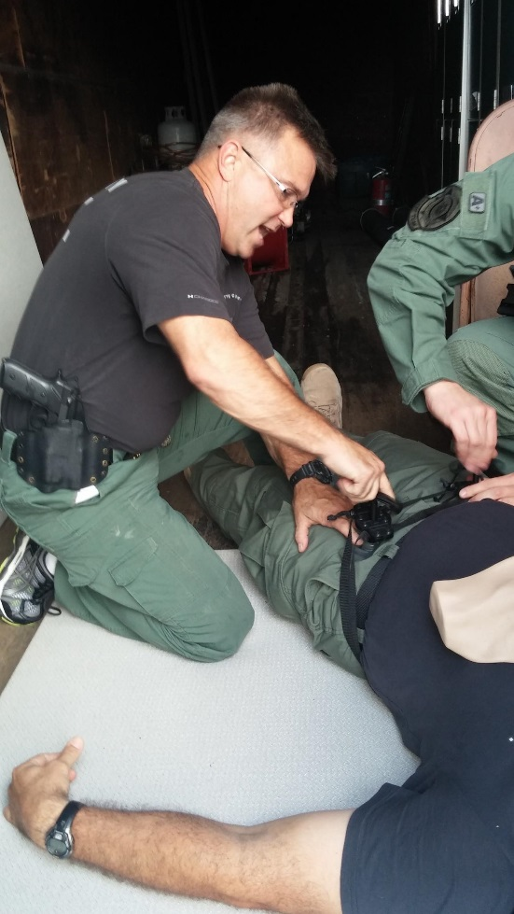
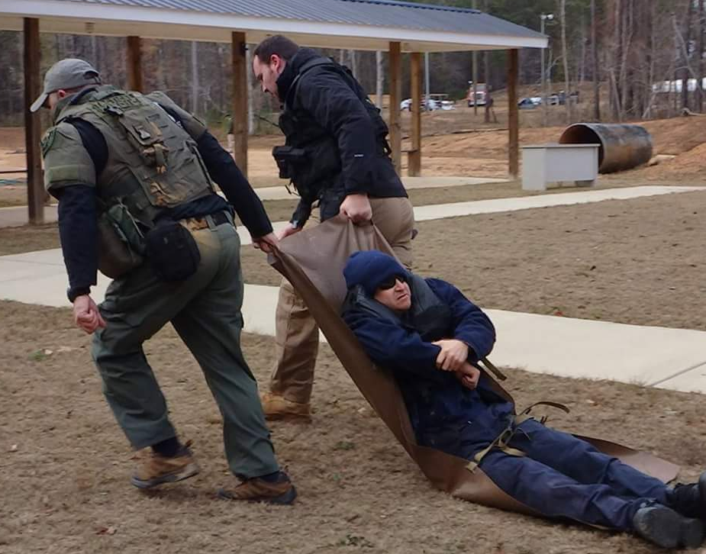
THREE PHASES OF TECC
  Direct Threat Care (Hot Zone)
  Scene of injury treat while under fire or direct threat
  Indirect Threat Care (Warm Zone)
  Rendered once the casualty is no longer under hostile fire or direct threat
  Casualty Collection Point
  Evacuation Care (Cold Zone)
  Care just prior to and during evacuation of casualty to a higher level of care.

Slide 5
Disarm Individuals With
Altered Mental Status
An armed casualty with an altered mental status may use weapons inappropriately.
Secure long gun, pistols, knives, and explosives.
Possible causes of altered mental status are head injury, shock, and hypoxia.
Say to the casualty, “Let me hold your weapon for you while the medic checks you out.”
Notes:
A casualty may resist being disarmed. Proposing to hold the casualty’s weapon while he or she is checked by the medic may help him or her to better accept the weapon being taken away.

Slide 6
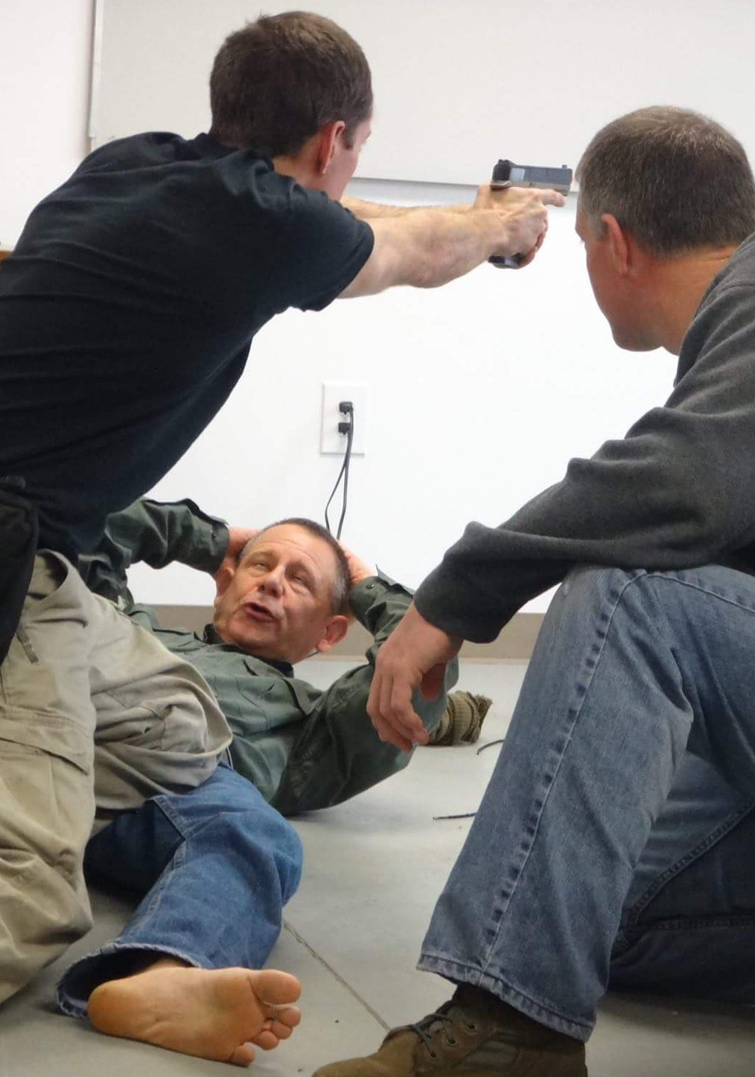
M-A-R-C-H
  Massive Hemorrhage
  Control life-threatening bleeding
  Tourniquet
  Direct Pressure
  Wound Packing
Direct pressure and tourniquet application are the only bleeding control methods used during Direct Threat Care.
Notes:
Massive Hemorrhage
Control life-threatening bleeding
Tourniquet
Direct Pressure
Wound Packing
Direct pressure and tourniquet application are the only bleeding control methods used during Direct Threat Care (Care Under Fire).
Also: During Direct Threat Care (Care Under Fire)
- Only Life-threatening bleeding should be address
- Tourniquets are the first choice for control of hemorrhage during care under fire

Slide 7
M-A-R-C-H
  Airway
  Establish and maintain a patent airway
  Patient Positioning - Recovery Position
  Manual Airway Maneuvers
  Casualties with severe facial injuries can often protect their own airway by sitting up and leaning forward.
Only treatment applied during Direct Threat Care.

Slide 8
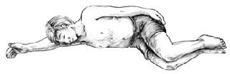
HAINES Position
Modified Recovery Position
High Arm IN Endangered Spine.

Slide 9
M-A-R-C-H
  Respirations
  Locate and treat injuries that are causing difficulty breathing
  Expose the chest and back
  Apply a vented chest seal to all wounds to the torso

Slide 10
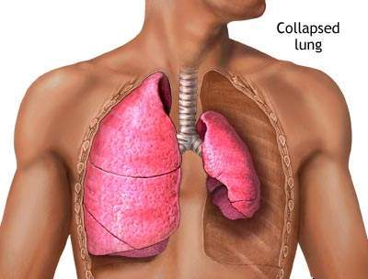
Pneumothorax
A pneumothorax is a collection of air between the lung and chest wall due to an injury to the lung (can be closed or open).
  May be due to blunt or penetrating trauma
An open pneumothorax (sucking chest wound) requires a chest wound that is large enough that air can move freely in and out of the chest.

Slide 11
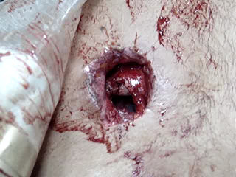
Sucking Chest Wound
Notes:
In this video of a sucking chest wound, note the large open hole in the chest wall.

Slide 12
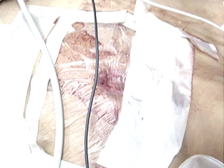
Sucking Chest Wound
Notes:
Negative pressure during inhalation retracts the dressing over the wound. The lung now has a better chance of reinflating.
Some treat this wound with Asherman or Hyfin valved dressings; while there are several animal studies that show that these dressings or a three-sided dressing are more effective than a simple occlusive dressing.

Slide 13
Sucking Chest Wound
Wound may interfere with ventilation.
Treat by applying a vented chest seal over the open wound.
Allow the casualty to adopt the sitting position if breathing is more comfortable.
Notes:
Negative pressure during inhalation retracts the dressing over the wound. The lung now has a better chance of reinflating.
Some treat this wound with Asherman or Hyfin valved dressings; while there are several animal studies that show that these dressings or a three-sided dressing are more effective than a simple occlusive dressing.

Slide 14
M-A-R-C-H
  Circulation
  Check for signs of shock
  Does the injured person have a radial pulse? Is the casualty alert?
  The best indicators of shock in Indirect Threat Care phase are:
    Decreased level of consciousness (in the absence of a head injury)AND/OR
    Abnormal character of the radial pulse (weak or absent)
  Be sure all bleeding is controlled, have or help the patient lie down.

Slide 15
M-A-R-C-H
Head injury/Hypothermia
  Prevent/treat hypotension and hypoxia to prevent worsening of traumatic brain injury (TBI), and prevent/treat hypothermia
  Keep the patient warm – decreasing body temperature inhibits the body’s ability to clot
  Constantly reassess patient to assure bleeding is controlled, airway remains patent, and shock is treated

Slide 16
Questions?
Questions? Questions?
Questions?
Questions?
Questions?
Questions?
Questions?
Questions?

