Slide 1




Instructor Orientation

Slide 2
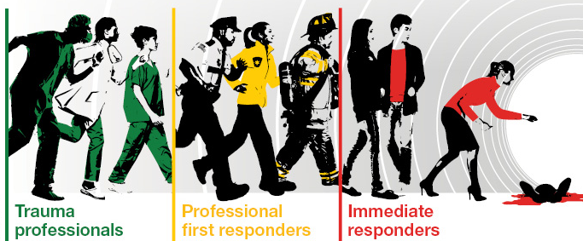

Who Can Teach?
STOP THE BLEED® - Improving Survival
There must be a continuum of care that begins with the initial responders and continues to definitive care.
Notes:
Note to instructor: Time permitting, provide brief overview of Hartford Consensus
The STOP THE BLEED® Campaign is designed to enable ordinary people to render immediate, potentially life-saving medical aid to the injured while await the arrival of professional responders.
Hartford Consensus: There must be a continuum of care that begins with the initial responders and continues to definitive care.
The Joint Committee to Increase Survival from Active Shooter and Intentional Mass Casualty Events – Convened in Hartford Con.
Recommendations represent the consensus opinion of a multi-disciplinary committee involving medical groups, the military, the National Security Council, Homeland Security, the FBI, law enforcement, fire rescue, and EMS
These recommendations have become known as the Hartford Consensus
To improve survival, there must be a continuum of care that begins with the initial responders and continues to definitive care.
These recommendations have become known as the Hartford Consensus. The overarching principle of the Hartford Consensus is that no one should die from
uncontrolled bleeding. The Hartford Consensus recommends that all citizens learn to stop bleeding.

Slide 3

STOP THE BLEED® - Improving Survival
no one should die
from uncontrolled bleeding
The public, as immediate responders, should know how to stop bleeding
Law enforcement, as first responding officers, should know how to stop bleeding
You can help by teaching the public to control bleeding
Notes:
The guiding principle of the Hartford Consensus recommendations is that “no one should die from uncontrolled bleeding.”
The public, as immediate responders, should know how to stop bleeding – they should be educated, equipped, and impowered to control bleeding.
Law enforcement, as first responding officers, should know how to stop bleeding
You can help by teaching the public to control bleeding

Slide 4
Who Can Teach?
Who Can Teach (1 of 2)
INSTRUCTOR ELIGIBILITY: Anyone that has successfully completed Bleeding Control training or STOP THE BLEED® Basic Course and meets the following professional requirements:
HEALTHCARE PROFESSIONALS
Certified Athletic Trainer
Certified Correctional Officer
Certified Lifeguard
Certified Nursing Assistant (CNA)
Certified Medical Assistant (CMA)
Certified Registered Nurse Anesthetist (CRNA)
Dentist (DMD/DDS)
Doctor of Chiropractic Medicine (DC)
Doctor of Osteopathic Medicine (DO)
Doctor of Pharmacy (PharmD)
Doctor of Podiatric Medicine (DPM)
Doctor of Veterinary Medicine (DVM)
Emergency Medical Responder (EMR)
Emergency Medical Technician (EMT)
Medical Doctor (MD)
Military Medic/Corpsman
Non-Clinical Injury Prevention Coordinator
Nurse Practitioner (NP)
Nurse (RN/LPN/LVN)
Occupational Therapist (OT)
Paramedic
Physical Therapist (PT)
Physician Assistant (PA)
Registered Dietitian (RD)
Registered Pharmacist (R.Ph)
Respiratory Therapist (RT)
Ski Patrol
Sworn Law Enforcement Officer
TCCC/TECC Instructor
Notes:
Note to instructor: This list is updated periodically and can be found at: https://cms.bleedingcontrol.org/applicant/create
INSTRUCTOR ELIGIBILITY: Anyone that has successfully completed Bleeding Control training or STOP THE BLEED® Basic Course and meets the following professional requirements:
HEALTHCARE PROFESSIONALS
Certified Athletic Trainer
Certified Correctional Officer
Certified Lifeguard
Certified Nursing Assistant (CNA)
Certified Medical Assistant (CMA)
Certified Registered Nurse Anesthetist (CRNA)
Dentist (DMD/DDS)
Doctor of Chiropractic Medicine (DC)
Doctor of Osteopathic Medicine (DO)
Doctor of Pharmacy (PharmD)
Doctor of Podiatric Medicine (DPM)
Doctor of Veterinary Medicine (DVM)
Emergency Medical Responder (EMR)
Emergency Medical Technician (EMT)
Medical Doctor (MD)
Military Medic/Corpsman
Non-Clinical Injury Prevention Coordinator
Nurse Practitioner (NP)
Nurse (RN/LPN/LVN)
Occupational Therapist (OT)
Paramedic
Physical Therapist (PT)
Physician Assistant (PA)
Registered Dietitian (RD)
Registered Pharmacist (R.Ph)
Respiratory Therapist (RT)
Ski Patrol
Sworn Law Enforcement Officer
TCCC/TECC Instructor

Slide 5
Who Can Teach?
Who Can Teach (2 of 2)
INSTRUCTOR ELIGIBILITY: Anyone that has successfully completed Bleeding Control training or STOP THE BLEED® Basic Course and meets the following professional requirements:
NON- HEALTHCARE PROFESSIONALS*
*Individuals under this category must complete and pass the online Interactive STOP THE BLEED® Course in addition to completing a full STOP THE BLEED® course prior to applying.
American Heart Association CPR/BLS Instructor
American Red Cross CPR Instructor
American Red Cross First Aid Instructor
National Safety Council trainer/instructor
OSHA Safety Instructor
Certified Health Teacher
Organization Safety and Health Instructors
FEMA Certified trainer
Wilderness First Responder Instructor
ASSOCIATE INSTRUCTORS:
Any Student of the above Healthcare disciplines who has STOP THE BLEED® Course or Bleeding Control training. Non-Clinical Injury Prevention Coordinators that are employed at an ACS verified or State designated Trauma Center and recommended by the Trauma Medical Director or Trauma Program Manager. Upon approval, please follow instructions provided in the confirmation email.
Notes:
Note to instructor: This list is updated periodically and can be found at: https://cms.bleedingcontrol.org/applicant/create
INSTRUCTOR ELIGIBILITY: Anyone that has successfully completed Bleeding Control training or STOP THE BLEED® Basic Course and meets the following professional requirements:
NON-HEALTHCARE PROFESSIONALS
Individuals under this category must complete and pass the online Interactive STOP THE BLEED® Course in addition to completing a full STOP THE BLEED® course prior to applying.
American Heart Association CPR/BLS Instructor
American Red Cross CPR Instructor
American Red Cross First Aid Instructor
National Safety Council trainer/instructor
OSHA Safety Instructor
Certified Health Teacher
Organization Safety and Health Instructors
FEMA Certified trainer
Wilderness First Responder Instructor
*Individuals under this category must complete and pass the online Interactive STOP THE BLEED® Course in addition to completing a full STOP THE BLEED® course prior to applying.
ASSOCIATE INSTRUCTORS:
Any Student of the above Healthcare disciplines who has STOP THE BLEED® Course or Bleeding Control training. Non-Clinical Injury Prevention Coordinators that are employed at an ACS verified or State designated Trauma Center and recommended by the Trauma Medical Director or Trauma Program Manager. Upon approval please follow instructions provided in the confirmation email.

Slide 6

Become an Instructor
Step 1: Take the STOP THE BLEED® Course
Step 2: Register to be an instructor on
the ACS instructor portal
Step 3: Plan your course:
Adhere to course guidelines
Acquire course resources
Step 4: Register your class and begin
teaching!
Notes:
Become a STOP THE BLEED® Course
Step 1: Take the STOP THE BLEED® Course
Step 2: Register to be an instructor on the ACS instructor portal
Step 3: Plan your course:
Adhere to course guidelines
Acquire course resources
Step 4: Register your class and begin teaching!

Slide 7

Step 1: Take the STOP THE BLEED® Course
HEALTHCARE PROFESSIONALS -
- meet the professional requirements
- complete a STOP THE BLEED® Course
NON-HEALTHCARE PROFESSIONALS -
- meet the professional requirements
- complete a STOP THE BLEED® Course
- complete and pass the online Interactive STOP THE BLEED®
Note: Participants must complete both the lecture AND the skills component of the STOP THE BLEED® Course to be considered COMPLETE and to receive a certificate of course completion.
Notes:
Step 1: Take the STOP THE BLEED® Course
HEALTHCARE PROFESSIONALS -
- meet the professional requirements:
- complete a STOP THE BLEED® Course
HEALTHCARE PROFESSIONALS -
- meet the professional requirements:
- complete a STOP THE BLEED® Course
- complete and pass the online Interactive STOP THE BLEED®
Note: Participants must complete both the lecture AND the skills component of the STOP THE BLEED® Course to be considered COMPLETE and to receive a certificate of course completion.

Slide 8
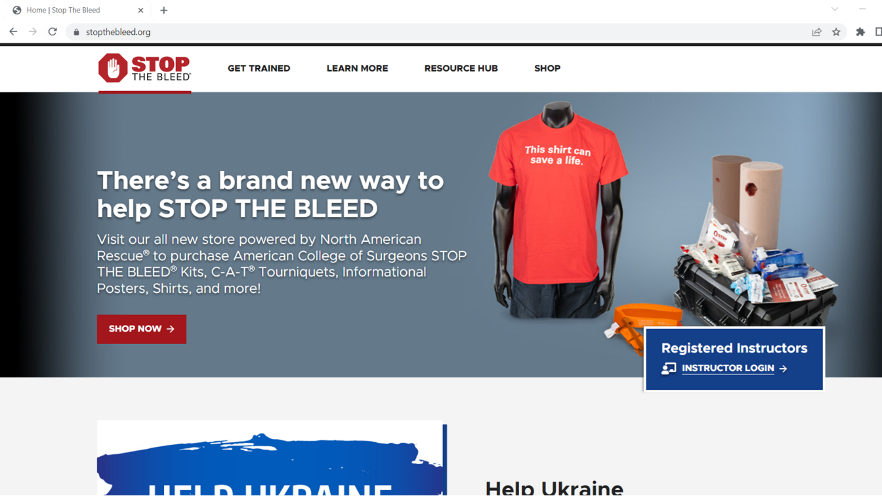
Step 2: Register on the ACS Instructor Portal
Visit:
www.stopthebleed.org
Click on:
“Instructor Login”
WWW.STOPTHEBLEED.ORG
Notes:
Step 2: Register on the ACS Instructor Portal
Visit: www.stopthebleed.org
Click on: “Instructor Login”

Slide 9
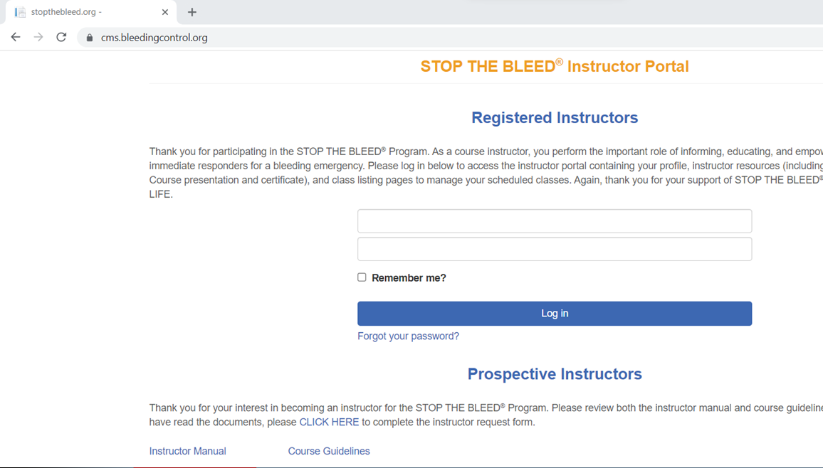
Step 2: Register on the ACS Instructor Portal
Instructor Portal:
Registered Instructors:
Enter your email and password, then log in
Prospective Instructors:
Review both the instructor manual and course guidelines
Once you have read the documents, please CLICK HERE to complete the instructor request form
Complete the application
WWW.STOPTHEBLEED.ORG
Notes:
Step 2: Register on the ACS Instructor Portal
Now you have reached the Instructor Portal login page.
Registered Instructors:
Enter your email and password, then log in.
Prospective Instructors:
Review both the instructor manual and course guidelines.
Once you have read the documents, please CLICK HERE to complete the instructor request form.
Note: “Sworn Law Enforcement Officer” is found under healthcare professional.

Slide 10
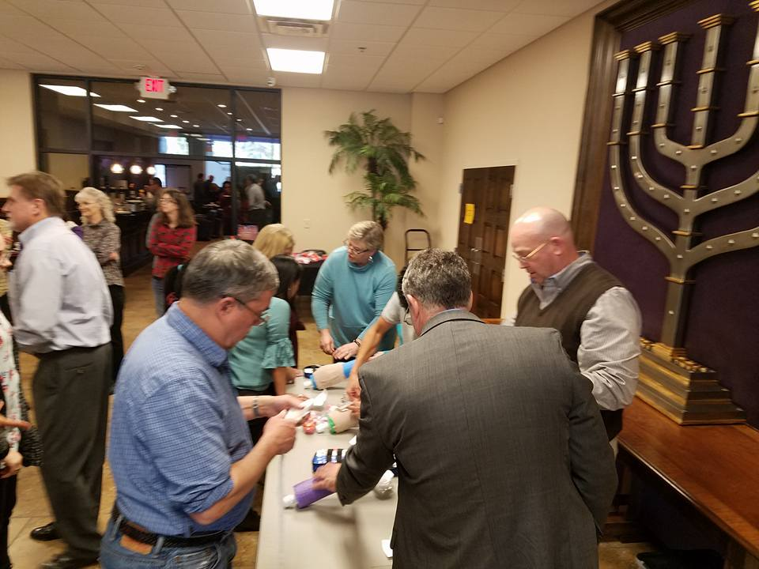
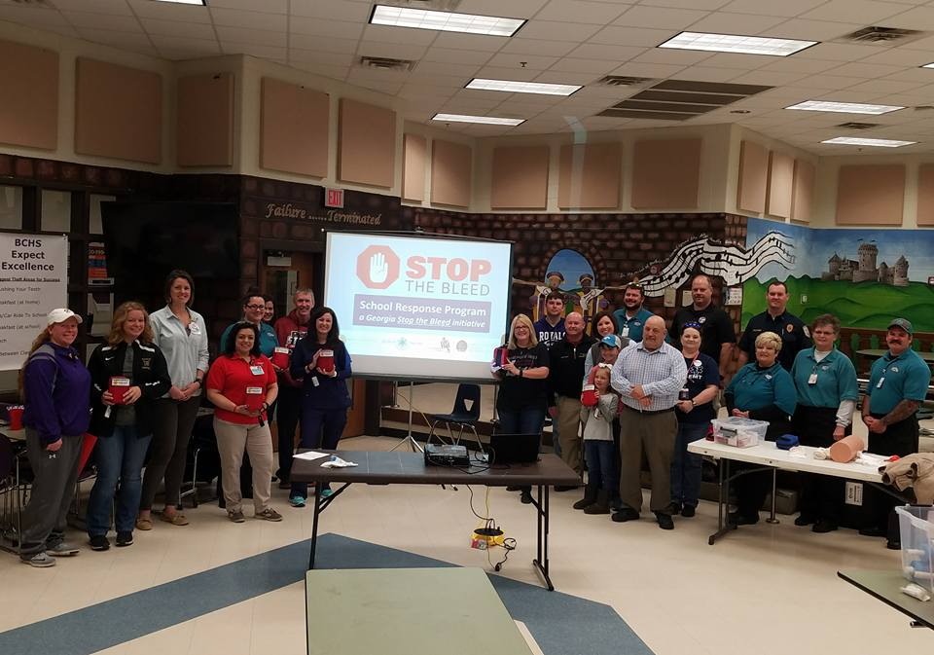
Step 3: Plan Your Course
Adhere to Course Guidelines
Course Options
Course Length
Instructor Ratio
Content
Documentation
Notes:
Note to instructor: Consider changing the pictures of classes to reflect your audience. Participants enjoy seeing people and locations they are familiar with.
Step 3: Plan Your Course
Adhere to Course Guidelines
Course Options - Traditional in-person, virtual followed by skills check-off, etc (will be reviewed in greater depth later in the presentations)
Participants must complete both the lecture AND the skills component of the STOP THE BLEED® Course to be considered COMPLETE and to receive a certificate of course completion.
Course Length – The course length varies with type of course, audience type, specific needs. The traditional STOP THE BLEED® Course generally lasts 1-2 hours.
Instructor Ratio - 8/10 students to 1 instructor.
Content – The STOP THE BLEED® presentation is available at www.stopthebleed.org.
Documentation – Register and “close” courses at www.stopthebleed.org. Maintain your own rosters. Provide general course data to regional STOP THE BLEED® Champion/RTAC Coordinator.

Slide 11
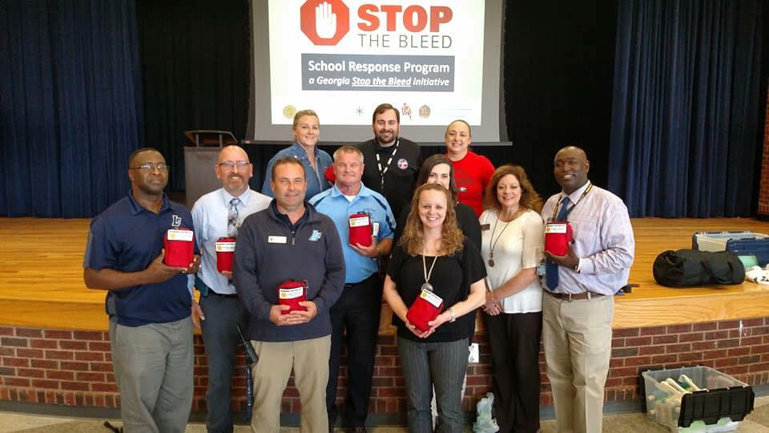
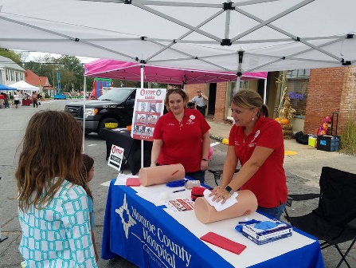
Program Delivery Options
American College of Surgeons STOP THE BLEED® Programming:
STOP THE BLEED® Course – Traditional In-Person Course
STOP THE BLEED® Lecture Only – Virtual Course
STOP THE BLEED® Lecture Only – Interactive Online Course
STOP THE BLEED® Skills Only – In-person Course
STOP THE BLEED® Skills Only – Virtual Course
Georgia Specific STOP THE BLEED® Programming:
STOP THE BLEED® Refresher Course w/ Hands-on Skills Training
STOP THE BLEED® Awareness Program w/ Hands-on Skills Training
STOP THE BLEED® Awareness Program In-Person/Virtual/Video Presentation
STOP THE BLEED® Instructor Orientation
Notes:
STOP THE BLEED® Training is more versatile than ever. The Georgia Trauma System uses American College of Surgeons STOP THE BLEED® course materials and instructors should adhere to course guidelines as prescribed in the Instructor portal.
As we review the various course options, keep in mind that participants must complete both the lecture AND the skills component of the STOP THE BLEED® Course to be considered COMPLETE and to receive a certificate of completion.
Georgia programming note. Certificates of program attendance or follow-up email correspondence can serve as verification of LECTURE ONLY or SKILLS ONLY offering attendance. These are provided for attendance verification purposes only and due not signify FULL COURSE completion. DO NOT use the American College of Surgeon’s Course Completion Certificates for this purpose.
American College of Surgeons STOP THE BLEED® Programming:
STOP THE BLEED® Course – Traditional In-Person Course
STOP THE BLEED® Lecture Only – Virtual Course
STOP THE BLEED® Lecture Only – Interactive Online Course
STOP THE BLEED® Skills Only – In-person Course
STOP THE BLEED® Skills Only – Virtual Course
Georgia Specific STOP THE BLEED® Programming:
STOP THE BLEED® Refresher Course w/ Hands-on Skills Training
STOP THE BLEED® Awareness Program w/ Hands-on Skills Training
STOP THE BLEED® Awareness Program In-Person/Virtual/Video Presentation
STOP THE BLEED® Instructor Orientation
Note:
Refresher Courses w/ Hands-On Skills Training and Awareness Programs w/ Hands-On Skills Training only provided abbreviated didactic content. Please report these courses as STOP THE BLEED® Skills Only courses when reporting to www.stopthebleed.org.

Slide 12
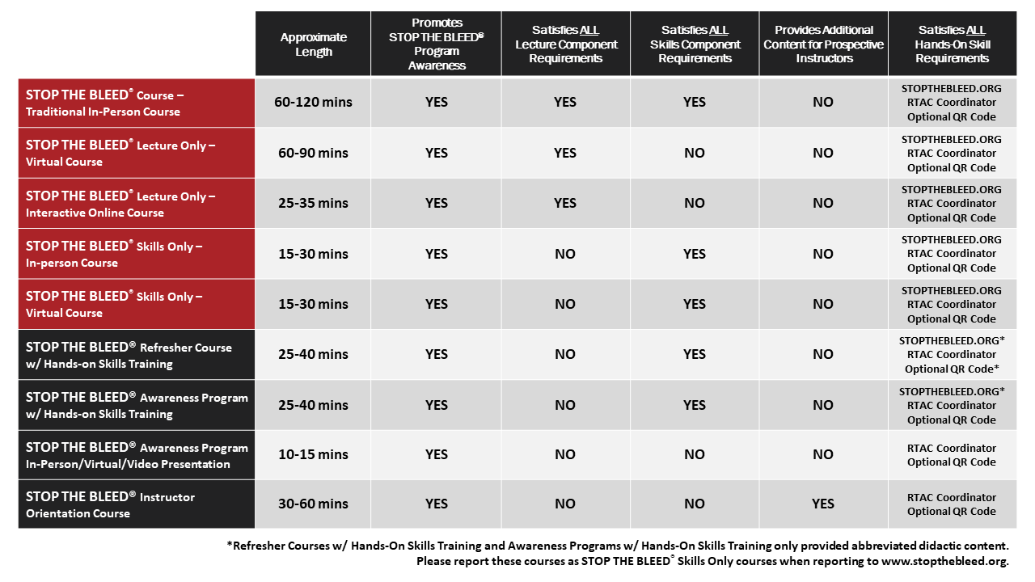
STOP THE BLEED® Course Options
Notes:
This slide provides a quick visual comparison of the various programming options. We will describe these options in more detail on the following slides.

Slide 13
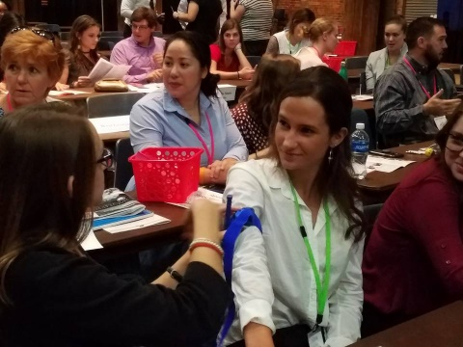
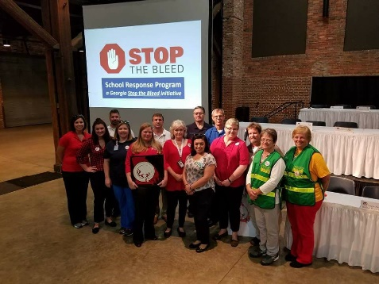
STOP THE BLEED®
Generally, lasts 1 - 2 hours
Traditional in-person course followed by hands on skills practice
8/10 students/instructor
The STOP THE BLEED® presentation is available in the instructor portal.
WWW.STOPTHEBLEED.ORG
Notes:
STOP THE BLEED® Course
The STOP THE BLEED® using live, in-person training to guide participants through the three methods of bleeding control using video demonstrations, interactive learning, and spontaneous quizzes.
The course length varies with audience type, specific needs. The traditional STOP THE BLEED® Course generally lasts 1-2 hours.
Traditional in-person course followed by hands on skills practice Participants complete both the lecture AND the skills components of the STOP THE BLEED® Course.
Instructor Ratio - 8/10 students to 1 instructor.
Content – The STOP THE BLEED® presentation is available in the Instructor Portal at www.stopthebleed.org.
Note: Instructors use training materials specially developed to teach bleeding control techniques. They provide live instruction, guidance, and feedback to students. They are available to check participants movements as they practice three different bleeding control actions. Instructors should keep working with course attendees until they demonstrate the correct skills to STOP THE BLEED® and save a life.
Documentation: Register and “close” courses at www.stopthebleed.org. Maintain your own rosters. Provide general course data to regional STOP THE BLEED® Champion/RTAC Coordinator.

Slide 14

STOP THE BLEED® Virtual Course
Generally, lasts 1 - 1.5 hours
Lecture only course
The STOP THE BLEED® presentation is available in the instructor portal.
Instructor must be present for entire training
WWW.STOPTHEBLEED.ORG
Notes:
The STOP THE BLEED® Course can be presented virtually.
The Virtual Course generally lasts 1 - 1.5 hours
Instructors may present the lecture through a virtual meeting platform utilizing the current presentation or can also elect to use the prerecorded version found in the Instructor Portal.
An instructor must be present through the entire virtual training.
Note: As a reminder, participants must complete both the lecture AND the skills component of the STOP THE BLEED® Course to be considered COMPLETE and to receive a certificate of completion.
Documentation: Register and “close” courses at www.stopthebleed.org. Maintain your own rosters. Provide general course data to regional STOP THE BLEED® Champion/RTAC Coordinator.
*Participation in virtual lecture training will be limited to the maximum number of participants your virtual meeting platform will host, there is not a STOP THE BLEED® Course participant limit to the lecture portion of the virtual course.

Slide 15
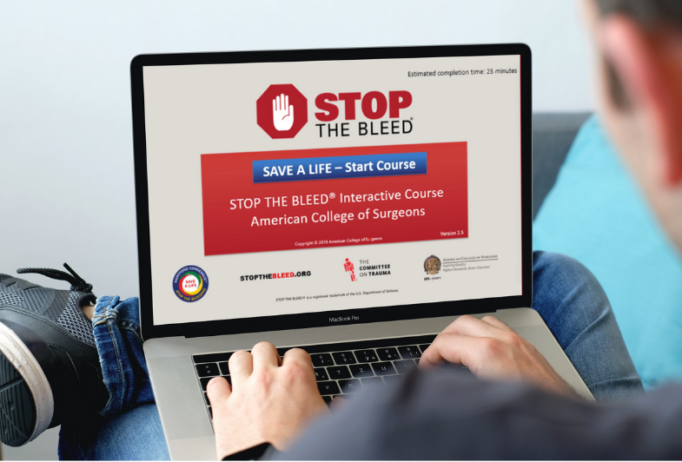
STOP THE BLEED® Interactive Course
25-35 minutes
Interactive, online, and on-demand
Video demonstrations, interactive learning, and spontaneous quizzes
Free to all students
Can be taken multiple times
WWW.STOPTHEBLEED.ORG
Notes:
STOP THE BLEED® Interactive Course - New Online Course Available
The STOP THE BLEED® Interactive Course guides participants through the three methods of bleeding control using video demonstrations, interactive learning, and spontaneous quizzes.
TAKE COURSE
Access: www.stopthebleed.org
25-35 minutes
Interactive, online, and on-demand - The interactive course is a virtual alternative to the in-person lecture presentation. The
Video demonstrations, interactive learning, and spontaneous quizzes - Interactive Course guides individuals through the three methods of bleeding control using video demonstrations, interactive learning, and spontaneous quizzes.
Free to all students
Can be taken multiple times - can be taken multiple times to learn and refresh knowledge of the STOP THE BLEED®
Note: While the interactive course fulfills the lecture portion, it does not allow them to receive a certificate of completion until they complete the hands-on skills portion of the course. The interactive course will encourage participants to attend either a full STOP THE BLEED® Course or a Skills-Only STOP THE BLEED® Course to receive their certificate of completion. At the conclusion of the course, they will receive an email with their final quiz results. Participants must show the instructor this document to receive a certificate of completion after they have completed the skills-only portion of the course.
How can viewers access the STOP THE BLEED® Interactive Course and Georgia’s National STOP THE BLEED® Month Education Survey?
To access the course with survey instructions, visit:
https://tinyurl.com/ACSOnlineSTB
To access the course directly, visit:
www.stopthebleed.org

Slide 16
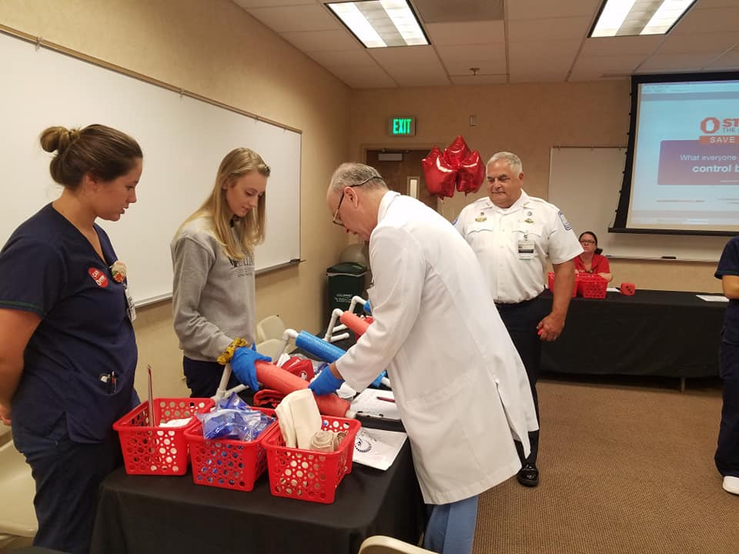
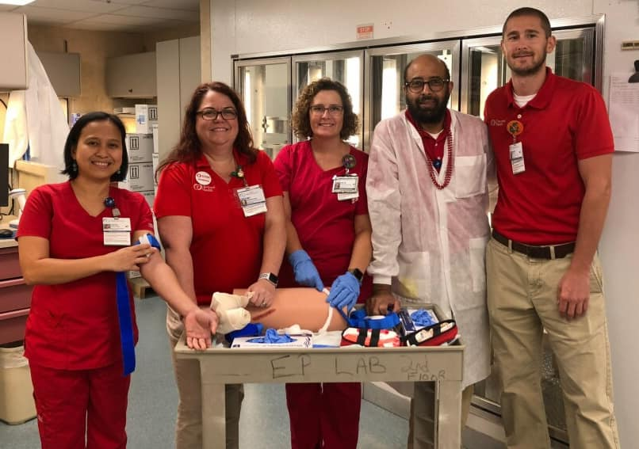
STOP THE BLEED® Skills Only Courses
~15 minutes per student/rotation
Session can be in-person or virtual
1:10 -instructor-to-student ratio
Session demo can be found in the Instructor Portal
WWW.STOPTHEBLEED.ORG
Notes:
The STOP THE BLEED® Skills Only Courses
At the conclusion of the virtual lecture-only courses, participants will require a reminder to schedule the skills portion to complete the STOP THE BLEED® Course requirements.
Instructors can schedule a skills-only training sessions through the Instructor Portal and should indicate if the course is public or private for maximum participation.
~15 minutes per student/rotation – will vary depending on situation. Instructors should keep working with course attendees until they demonstrate the correct skills to STOP THE BLEED® and save a life.
Session can be in-person or virtual – In-person instruction is preferred…especially for those without previous experience.
1:10 -instructor-to-student ratio - Regardless of being in-person or virtual, the STOP THE BLEED® Skills Only Course must meet the 1:10 -instructor-to-student ratio and be reflected in the Instructor Portal properly.
Session demo can be found in the Instructor Portal - Instructors should review the virtual instructor skills video as a guide on how to train the skills-only portion of the course.
Note: As a reminder, participants must complete both the lecture AND the skills component of the STOP THE BLEED® Course to be considered COMPLETE and to receive a certificate of completion.
Documentation: Register and “close” courses at www.stopthebleed.org. Maintain your own rosters. Provide general course data to regional STOP THE BLEED® Champion/RTAC Coordinator.

Slide 17
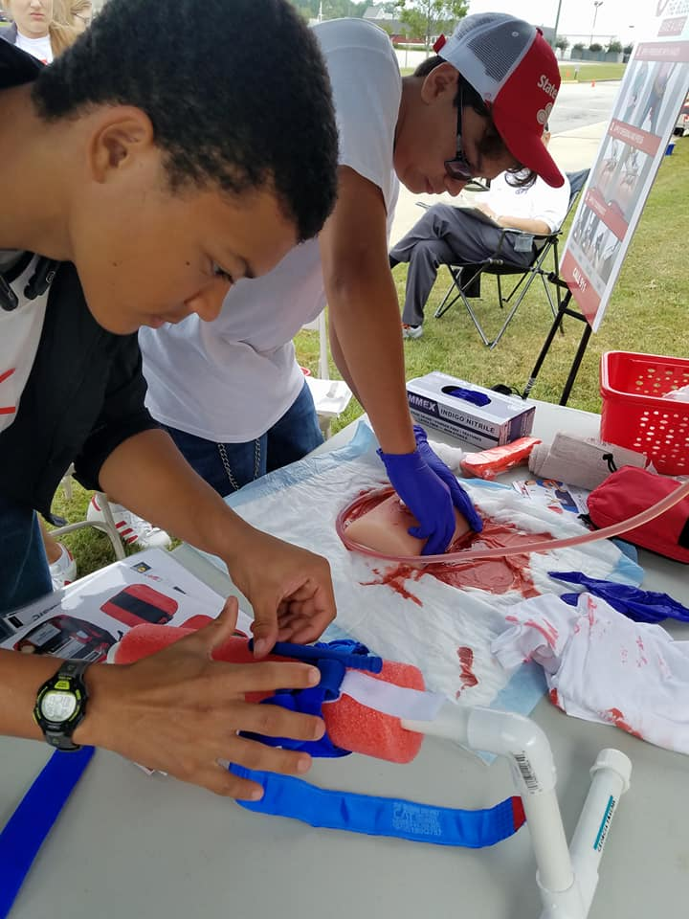
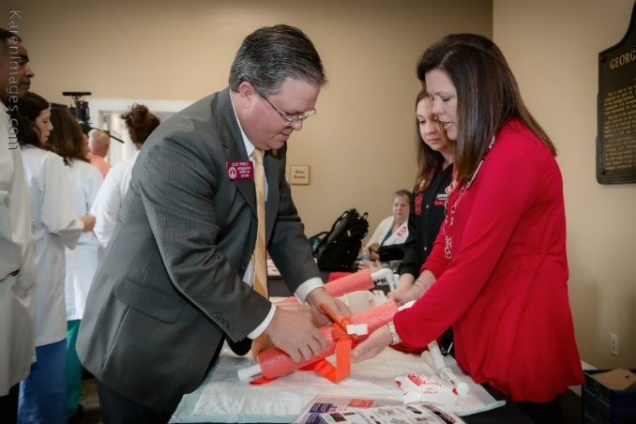
Refresher and Awareness offerings
Abbreviated instruction - designed to offer awareness level training to audiences with time limitations
If including skills instruction and return skills demos by participants - reported as Skills Only courses*
May include video instruction or abbreviated presentations.
*Be sure participants are provided adequate opportunity to practice all associated skills.
Notes:
Refresher and Awareness offerings
Abbreviated instruction - designed to offer awareness level training to audiences with time limitations
If including skills instruction and return skills demos by participants - reported as Skills Only courses*
May include video instruction or abbreviated presentations.
Great for staff meetings, in-services, etc. This is a wonderful opportunity to use the training video developed by the Georgia Trauma Commission.
*Be sure participants are provided adequate opportunity to practice all associated skills.

Slide 18
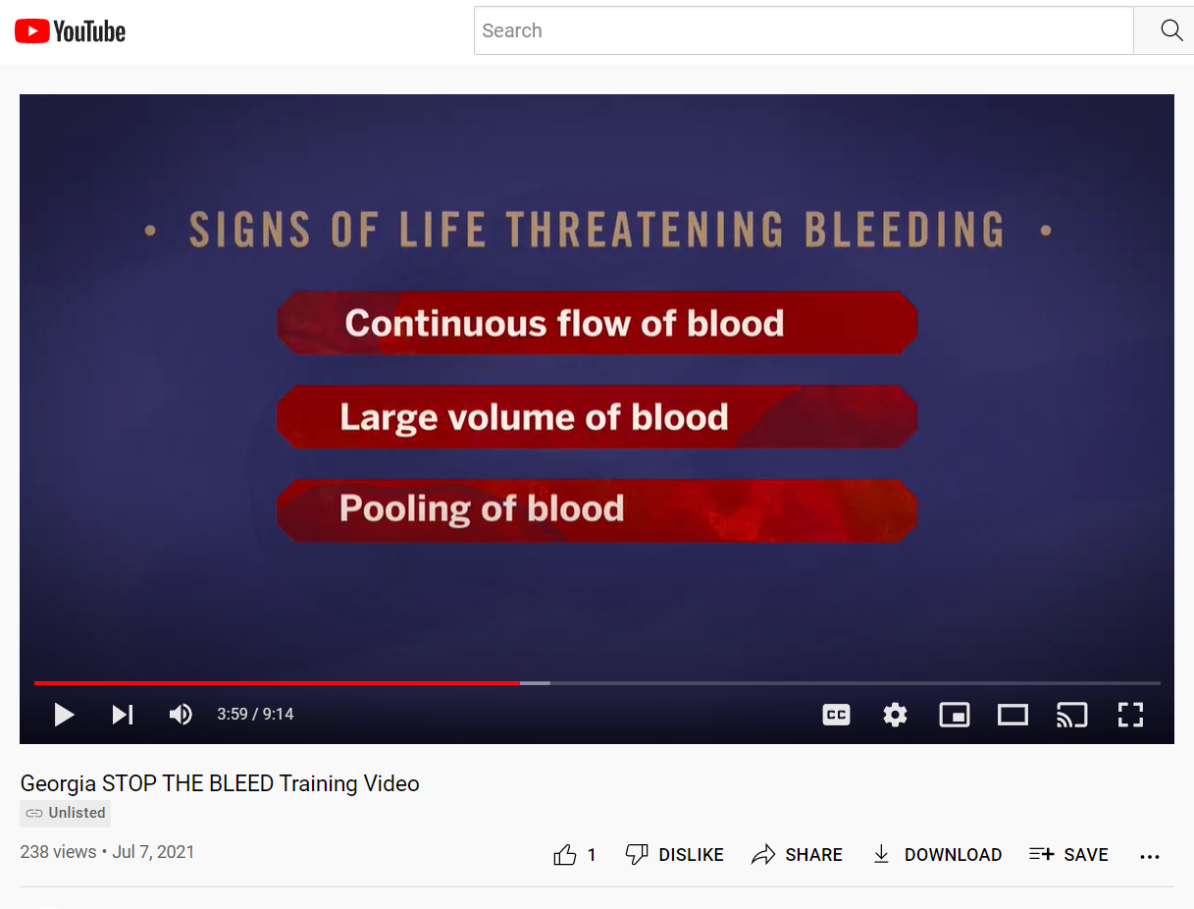
STOP THE BLEED® Awareness Video
Developed by the Georgia Trauma Commission
Designed to offer awareness level training to general audiences
Highlights the key concepts of hemorrhage control for traumatic injury
Notes:
STOP THE BLEED® Awareness Video
May include video instruction or abbreviated presentations.
*Be sure participants are provided adequate opportunity to practice all associated skills.
The Georgia Trauma Commission has developed a short video designed to highlight the key concepts of hemorrhage control for traumatic injury.
Watch this short video to learn more. Then complete our optional survey and you will be entered into our weekly drawing for STOP THE BLEED® Awareness Month Prizes.
How can viewers access the video and the National STOP THE BLEED® Month Education Survey?
To access the video with survey instructions, visit:
https://tinyurl.com/GASTBVid
To access the video via its direct YouTube Link, visit
https://www.youtube.com/watch?v=QxZhvjnTwG8

Slide 19
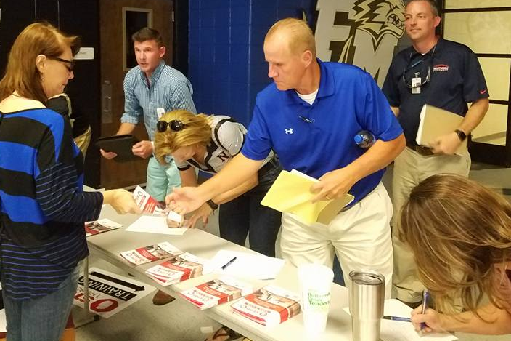
Step 3: Plan Your Course
Acquire Course Resources
Presentation
Booklets
Certificates
Training Equipment
Notes:
Step 3: Plan Your Course
Acquire Course Resources
The presentation, booklets, and certificates are available in the Instructor Portal. Just click on “Instructor Materials”. Your regional STOP THE BLEED® may have a limited quantity of printed resources available.
The next slide will discuss training equipment.
Note to instructor: Time permitting, consider navigating the Instructor Materials section of the Instructor Portal

Slide 20

Step 3: Plan Your Course
Training Equipment
Personal protective equipment
Hemorrhage control devices
Manikin or wound-packing model
Notes:
Step 3: Plan Your Course
Acquire Course Resources - Training Equipment
Personal protective equipment (PPE) (gloves)
Hemorrhage control devices (tourniquet, gauze rolls)
Manikin or wound-packing model
Note: All students must have access, at a minimum, to the equipment needed to complete the skill stations. The equipment can either be supplied in each skill station or provided to each group of students. All equipment must be clean and in proper working order.
Acquisition Strategies:
Buy
Borrow
Build

Slide 21
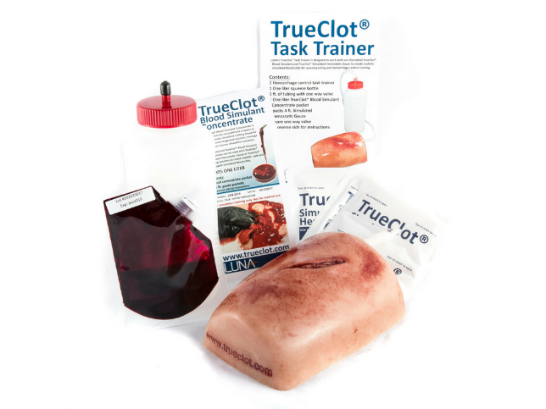
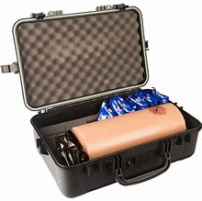
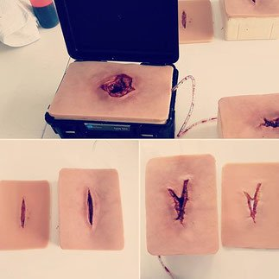
Step 3: Plan Your Course
Notes:
Step 3: Plan Your Course
Acquire Course Resources - Training Equipment
Buy - Examples of commercially available wound packing trainers.
Note to instructor: Time permitting, consider discussing pros and cons of various types of training equipment

Slide 22
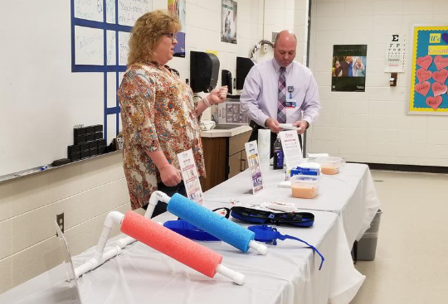
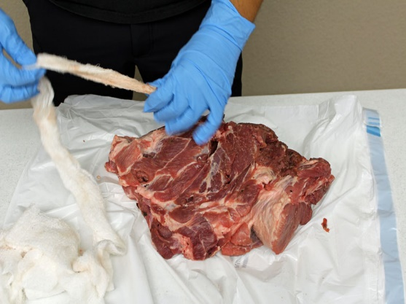
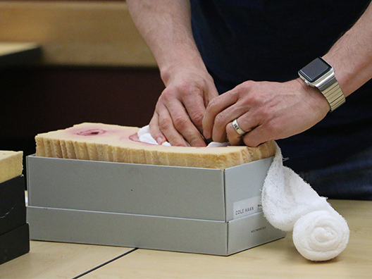
Step 3: Plan Your Course
Notes:
Step 3: Plan Your Course
Acquire Course Resources - Training Equipment
Build - Examples of improvised wound packing trainers.
Note to instructor: Time permitting, consider discussing pros and cons of various types of training equipment

Slide 23
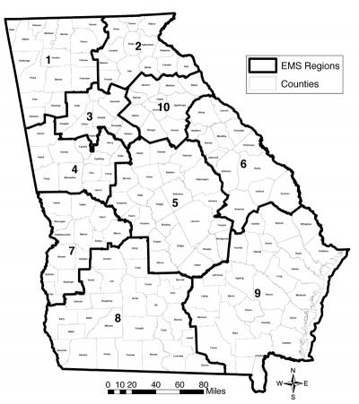
Regional Resources
STB “Champions”
Training equipment caches
Technical Assistance
Volunteers
Reporting mechanism
*Please allow sufficient lead time so that we/they can better assist you.
Notes:
Step 3: Plan Your Course
Acquire Course Resources - Training Equipment
Borrow – Contact your regional STOP THE BLEED® Champion
Note: STOP THE BLEED® Champions are designated by their Regional Trauma Advisory Committees or Regional EMS Council to “champion” this life-saving community resilience initiative within their region. They are experienced STOP THE BLEED® Instructors and are passionate about the provision of bleeding control training.
While the role may be filled by the Regional RTAC Coordinator, Champions are considered to be voluntarily appointed. Meaning, this is not a paid position, and your Champion likely works full-time in another capacity. When making a request, please allow sufficient lead time so that we/they can better assist you.
Regional Resources - STB “Champions”
Training equipment caches - STB Champions may have equipment available to be “checked out” from their regional caches.
Technical Assistance - STB Champions may be able to provided technical assistance and access to a limited quantity of printed resources. (booklets, certificates)
Volunteers - STB Champions may be able to assist you in recruiting STN Instructors and Volunteers
Reporting mechanism - STB Champions serve as a reporting mechanism for STB courses in Georgia. Please report your STB course information to the ACS using the instructor portal and to your STB Champion and/or RTAC Coordinator.

Slide 24
Step 4: Register Your Class in the Portal
Visit:
www.stopthebleed.org
Click on:
“Instructor Login”
WWW.STOPTHEBLEED.ORG
Notes:
Step 4: Register Your Class in the Portal
Visit: www.stopthebleed.org
Click on: “Instructor Login”

Slide 25
Step 4: Register Your Class in the Portal
Instructor Portal:
Registered Instructors:
Enter your email and password, then log in
WWW.STOPTHEBLEED.ORG
Notes:
Step 4: Register Your Class in the Portal
Now you have reached the Instructor Portal login page.
Registered Instructors:
Enter your email and password, then log in.
Note: “Sworn Law Enforcement Officer” is found under healthcare professional.

Slide 26
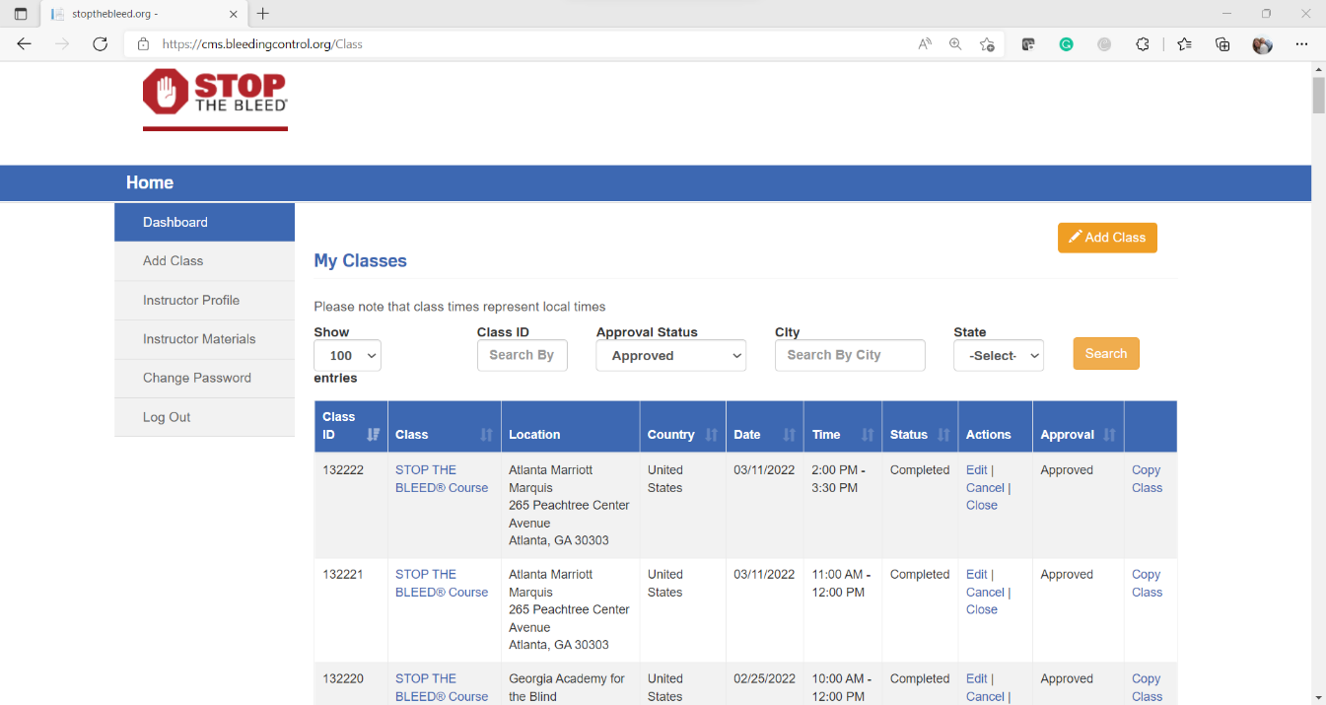
Step 4: Register Your Class in the Portal
Click on:
“Add Class”
Then enter your
course information.
WWW.STOPTHEBLEED.ORG
Notes:
Step 2: Register on the ACS Instructor Portal
Visit: www.stopthebleed.org
Click on: “Instructor Login”

Slide 27
Step 4: Register Your Class in the Portal
Click on:
“Add Class”
Then enter your
course information.
WWW.STOPTHEBLEED.ORG
Notes:
Step 2: Register on the ACS Instructor Portal
Visit: www.stopthebleed.org
Click on: “Instructor Login”

Slide 28
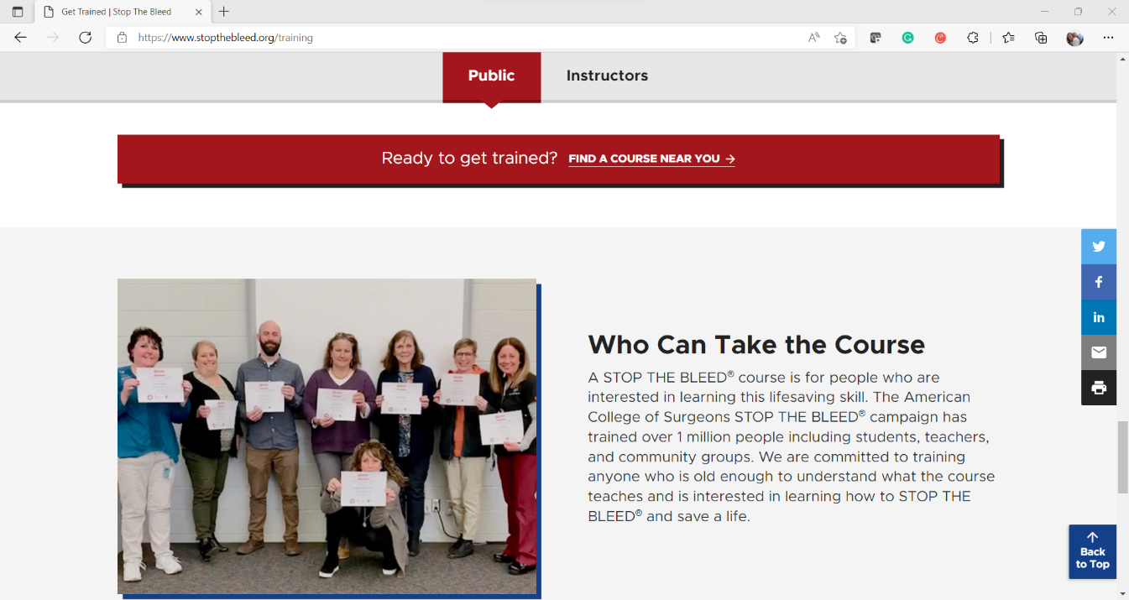

Step 4: Register Your Class in the Portal
Benefits:
Allows members of the public to find courses across the country with ease
One accessible location for entering course data
WWW.STOPTHEBLEED.ORG
Notes:
Step 4: Register Your Class in the Portal
Benefits:
Allows members of the public to find courses across the country with ease
One accessible location for entering course data

Slide 29
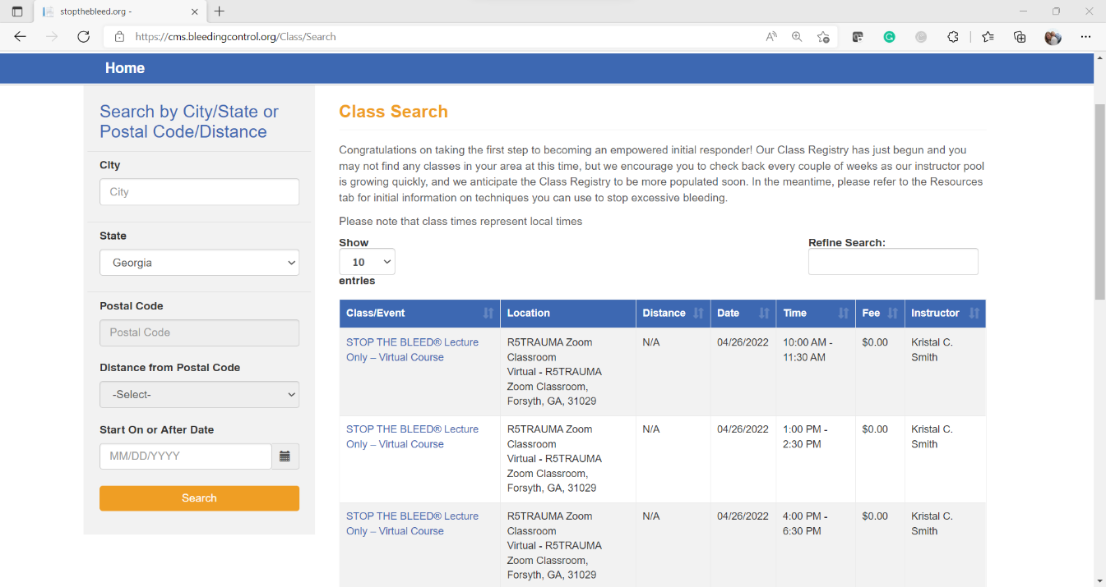

Step 4: Register Your Class in the Portal
Benefits:
Allows members of the public to find courses across the country with ease.
One accessible location for entering course data.
WWW.STOPTHEBLEED.ORG
Notes:
Step 4: Register Your Class in the Portal
Benefits:
Allows members of the public to find courses across the country with ease
One accessible location for entering course data

Slide 30

GA STOP THE BLEED® Instructor Registration
Optional - does not replace ACS Instructor Portal Registration
Allows members of the public to find instructors across Georgia with ease
Only County, Region, Name, Organization, and Email Address are included on list
Allows instructors to receive Georgia specific STOP THE BLEED® notifications
WWW.STOPTHEBLEEDGEORGIA.ORG
Notes:
This Instructor Registration is designed to provide a mechanism for accessing STOP THE BLEED® instructors providing community-based trainings in Georgia. All STOP THE BLEED® instructors are welcome to participate. Instructors can determine whether their information is posted publicly.* This registration is not intended to spam instructors with products and service and discretion will used when sending e-mail to the participating instructors based on this list. You can change our update this information by resubmitting your information. *The listing of STOP THE BLEED® instructors will be at least once each quarter. This Instructor Registration is provided as a resource and a courtesy, we do not validate email addresses.

Slide 31
GA STOP THE BLEED® Instructor Registration
How does it work?
Members of the public making STOP THE BLEED® Course requests are directed to the Local Instructors first.
If no local instructors are available, they are then connected with their regional STOP THE BLEED® Champion
WWW.STOPTHEBLEEDGEORGIA.ORG
Notes:
GA STOP THE BLEED® Instructor Registration
How does it work?
Members of the public making STOP THE BLEED® Course requests are directed to the Local Instructors first.
If no local instructors are available, they are then connected with their regional STOP THE BLEED® Champion
WWW.STOPTHEBLEEDGEORGIA.ORG
Direct link: STOP THE BLEED® Georgia Survey
This instructor list is designed to provide a mechanism for accessing STOP THE BLEED® instructors providing community-based training in Georgia.
All STOP THE BLEED® instructors are welcome to participate.
Instructors can determine whether their information is shared publicly.
The listing of STOP THE BLEED® instructors is updated at least once quarterly.
This instructor list is provided as a resource and a courtesy – we do not validate email addresses.
STOP THE BLEED® Georgia is not a credentialing organization or regulatory agency.

Slide 32
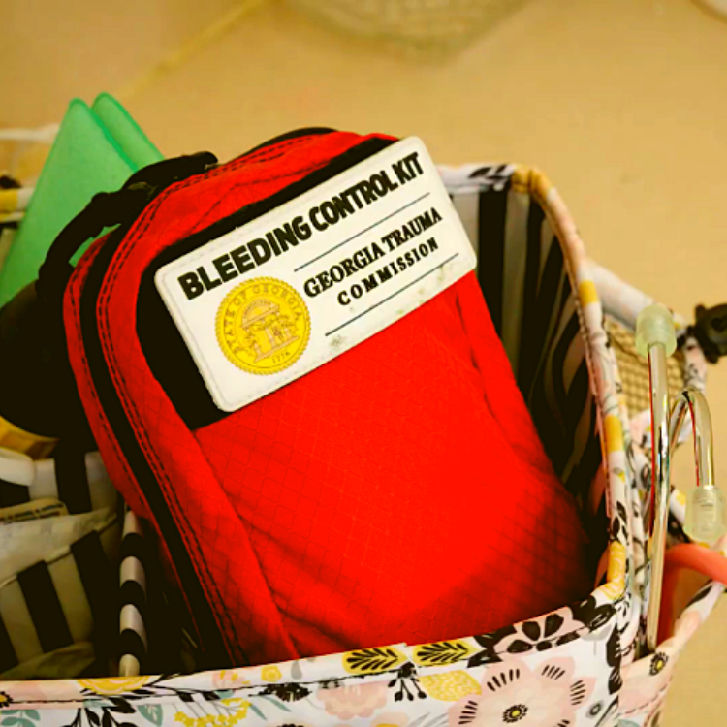
“Georgia Kit”
North American Rescue Cost per kit: $39.98 Item #: 85-1563 Phone: 888.689.6277 Email: info@NARescue.com
Notes:
Bleeding Control Kits like the ones we use in training can be purchased from a number of vendors and are also available at www.stopthebleed.org and www.stopthebleedcoalition.org.
The small Bleeding Control Kits or “Georgia Kits” being provided to public schools state-wide by the Georgia Trauma Commission are being made by North American Rescue. ANY agency, institution, business or individual may contact customer service at North American Rescue (1-888-689-6277) and request a quote OR order the “Georgia” kit(s) using item number 85-1563. Currently, the price for GEORGIA RESIDENTS purchasing the GEORGIA KIT is $39.98 per kit.
Note: The Georgia Kit cannot be ordered only. North American Rescue will need to be contacted directly to request a quote or place an order.
Also, we DO NOT sell Georgia Kits, nor to we make money from the sale of the Georgia Kits. In general, STOP THE BLEED® instructors are poor.

Slide 33

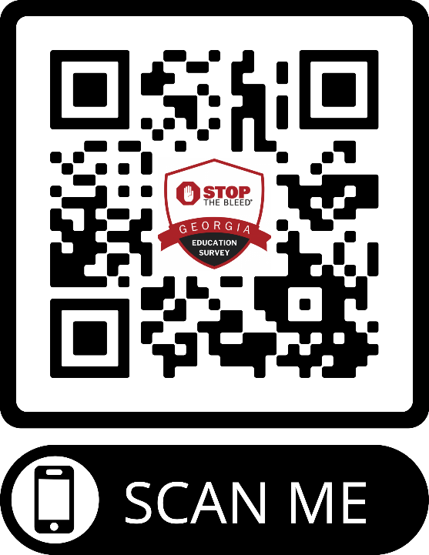
IMPORTANT SURVEY!:
National STOP THE BLEED® Month
Training Blitz - Education Survey
Be Sure to Enter the Following…
Program Type:
STOP THE BLEED® Instructor Orientation
Program Location:
ONLINE
Program Number:
55551
https://www.surveymonkey.com/r/GASTOPTHEBLEED
Notes:
Use this slide for the following course types
STOP THE BLEED® Instructor Orientation

