Slide 1




STB Education Survey

Slide 2

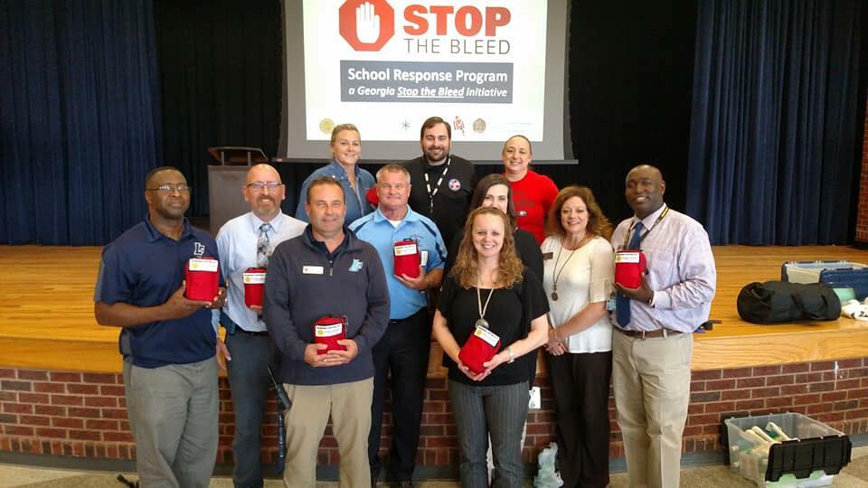
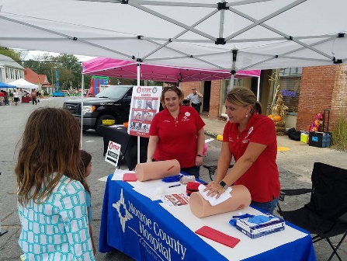

Program Delivery Options
American College of Surgeons STOP THE BLEED® Programming:
STOP THE BLEED® Course – Traditional In-Person Course
STOP THE BLEED® Lecture Only – Virtual Course
STOP THE BLEED® Lecture Only – Interactive Online Course
STOP THE BLEED® Skills Only – In-person Course
STOP THE BLEED® Skills Only – Virtual Course
Georgia Specific STOP THE BLEED® Programming:
STOP THE BLEED® Refresher Course w/ Hands-on Skills Training
STOP THE BLEED® Awareness Program w/ Hands-on Skills Training
STOP THE BLEED® Awareness Program In-Person/Virtual/Video Presentation
STOP THE BLEED® Instructor Orientation
Notes:
STOP THE BLEED® Training is more versatile than ever. The Georgia Trauma System uses American College of Surgeons STOP THE BLEED® course materials and instructors should adhere to course guidelines as prescribed in the Instructor portal.
As we review the various course options, keep in mind that participants must complete both the lecture AND the skills component of the STOP THE BLEED® Course to be considered COMPLETE and to receive a certificate of completion.
Georgia programming note. Certificates of program attendance or follow-up email correspondence can serve as verification of LECTURE ONLY or SKILLS ONLY offering attendance. These are provided for attendance verification purposes only and due not signify FULL COURSE completion. DO NOT use the American College of Surgeon’s Course Completion Certificates for this purpose.
American College of Surgeons STOP THE BLEED® Programming:
STOP THE BLEED® Course – Traditional In-Person Course
STOP THE BLEED® Lecture Only – Virtual Course
STOP THE BLEED® Lecture Only – Interactive Online Course
STOP THE BLEED® Skills Only – In-person Course
STOP THE BLEED® Skills Only – Virtual Course
Georgia Specific STOP THE BLEED® Programming:
STOP THE BLEED® Refresher Course w/ Hands-on Skills Training
STOP THE BLEED® Awareness Program w/ Hands-on Skills Training
STOP THE BLEED® Awareness Program In-Person/Virtual/Video Presentation
STOP THE BLEED® Instructor Orientation
Note:
Refresher Courses w/ Hands-On Skills Training and Awareness Programs w/ Hands-On Skills Training only provided abbreviated didactic content. Please report these courses as STOP THE BLEED® Skills Only courses when reporting to www.stopthebleed.org.

Slide 3


IMPORTANT SURVEY!:
Georgia STOP THE BLEED®
Education Survey
Be Sure to Enter the Following…
Program Type:
<<<YOUR PROGRAM TYPE HERE>>>
Program Location:
<<<YOUR PROGRAM LOCATION HERE>>>
Program Number:
<<<ACS STB PROGRAM NUMBER HERE>>>
https://www.surveymonkey.com/r/GASTOPTHEBLEED
Notes:
Use this slide for the following course types:
STOP THE BLEED® Course – Traditional In-Person Course
STOP THE BLEED® Lecture Only – Virtual Course
STOP THE BLEED® Skills Only – In-person Course
STOP THE BLEED® Skills Only – Virtual Course
STOP THE BLEED® Refresher Course w/ Hands-on Skills Training
STOP THE BLEED® Awareness Program w/ Hands-on Skills Training
STOP THE BLEED® Awareness Program In-Person/Virtual/Video Presentation

Slide 4
IMPORTANT SURVEY!:
Georgia STOP THE BLEED®
Education Survey
Be Sure to Enter the Following…
Program Type:
STOP THE BLEED®
Awareness Program – Video Presentation
Program Location:
ONLINE
Program Number:
99999
https://www.surveymonkey.com/r/GASTOPTHEBLEED
Notes:
Use this slide for the following course types
Awareness Program – Video Presentation
Access Video with Instructions:
https://tinyurl.com/GASTBVid
Direct YouTube Link:
https://www.youtube.com/watch?v=QxZhvjnTwG8

Slide 5
IMPORTANT SURVEY!:
Georgia STOP THE BLEED®
Education Survey
Be Sure to Enter the Following…
Program Type:
STOP THE BLEED® Online Interactive Course
Program Location:
ONLINE
Program Number:
00000
https://www.surveymonkey.com/r/GASTOPTHEBLEED
Notes:
Use this slide for the following course types
STOP THE BLEED® Online Interactive Course
Access Video with Instructions:
https://tinyurl.com/GASTBVid
Direct YouTube Link:
https://www.youtube.com/watch?v=QxZhvjnTwG8

Slide 6
IMPORTANT SURVEY!:
Georgia STOP THE BLEED®
Education Survey
Be Sure to Enter the Following…
Program Type:
STOP THE BLEED® Instructor Orientation
Program Location:
ONLINE
Program Number:
55555
https://www.surveymonkey.com/r/GASTOPTHEBLEED
Notes:
Use this slide for the following course types
STOP THE BLEED® Instructor Orientation

Slide 7
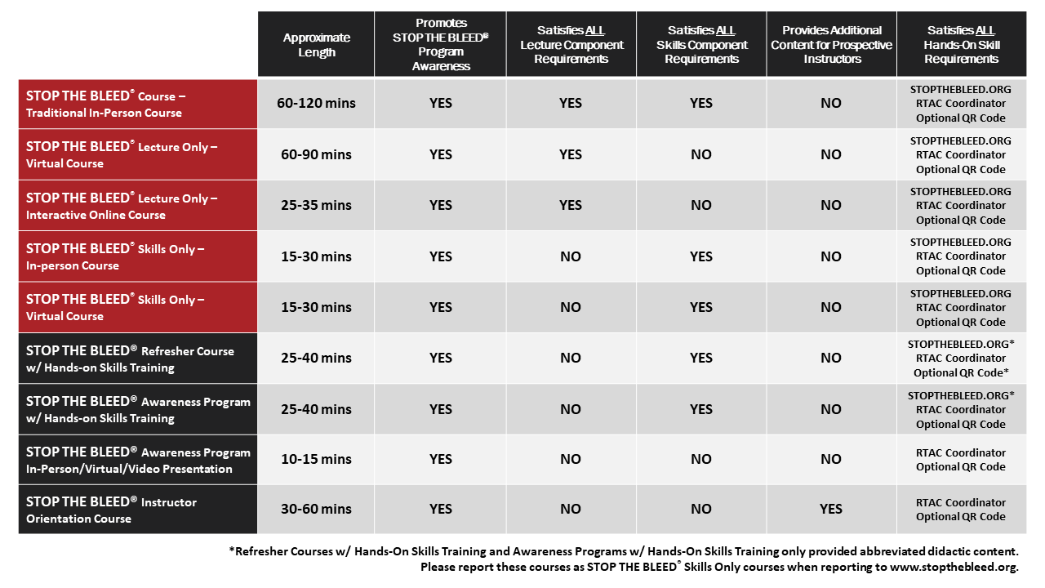
STOP THE BLEED® Course Options
Notes:
This slide provides a quick visual comparison of the various programming options. We will describe these options in more detail on the following slides.

