Slide 1




Jan 2022 Winter Training Blitz

Slide 2

GA STOP THE BLEED® Training Blitz
January 2023
Regional Course Offerings
Webinars • Skills Courses • Refresher Courses
& More
All Georgia Trauma Centers and System Partners are encouraged to be involved!
#stopthebleedgeorgia #preventtrauma

Slide 3
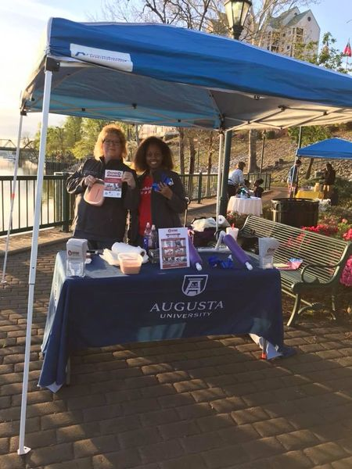
Call to Action
Promote the GA Trauma System STOP THE BLEED® Day Webinar
Schedule your own STOP THE BLEED® training event for your community and staff
Take advantage of opportunities that are already on your calendar
(i.e.: trauma course offerings, council meetings,
coalition meetings, health fairs, etc)
#stopthebleedgeorgia #preventtrauma

Slide 4
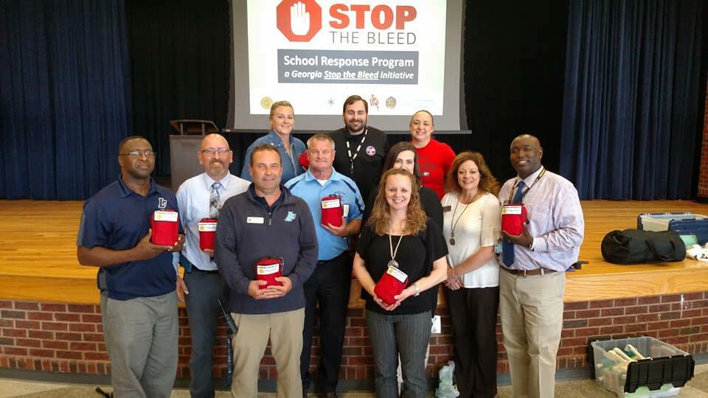
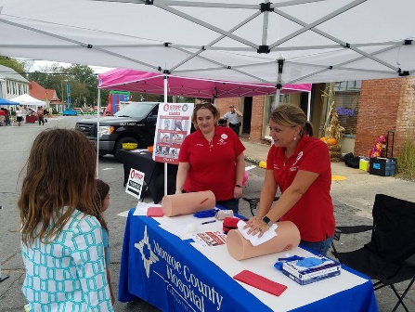

Program Delivery Options
American College of Surgeons STOP THE BLEED® Programming:
STOP THE BLEED® Course – Traditional In-Person Course
STOP THE BLEED® Lecture Only – Virtual Course
STOP THE BLEED® Lecture Only – Interactive Online Course
STOP THE BLEED® Skills Only – In-person Course
STOP THE BLEED® Skills Only – Virtual Course
Georgia Specific STOP THE BLEED® Programming:
STOP THE BLEED® Refresher Course w/ Hands-on Skills Training
STOP THE BLEED® Awareness Program w/ Hands-on Skills Training
STOP THE BLEED® Awareness Program In-Person/Virtual/Video Presentation
STOP THE BLEED® Instructor Orientation
Notes:
STOP THE BLEED® Training is more versatile than ever. The Georgia Trauma System uses American College of Surgeons STOP THE BLEED® course materials and instructors should adhere to course guidelines as prescribed in the Instructor portal.
As we review the various course options, keep in mind that participants must complete both the lecture AND the skills component of the STOP THE BLEED® Course to be considered COMPLETE and to receive a certificate of completion.
Georgia programming note. Certificates of program attendance or follow-up email correspondence can serve as verification of LECTURE ONLY or SKILLS ONLY offering attendance. These are provided for attendance verification purposes only and due not signify FULL COURSE completion. DO NOT use the American College of Surgeon’s Course Completion Certificates for this purpose.
American College of Surgeons STOP THE BLEED® Programming:
STOP THE BLEED® Course – Traditional In-Person Course
STOP THE BLEED® Lecture Only – Virtual Course
STOP THE BLEED® Lecture Only – Interactive Online Course
STOP THE BLEED® Skills Only – In-person Course
STOP THE BLEED® Skills Only – Virtual Course
Georgia Specific STOP THE BLEED® Programming:
STOP THE BLEED® Refresher Course w/ Hands-on Skills Training
STOP THE BLEED® Awareness Program w/ Hands-on Skills Training
STOP THE BLEED® Awareness Program In-Person/Virtual/Video Presentation
STOP THE BLEED® Instructor Orientation

Slide 5
Reporting & STB Education Survey

Slide 6

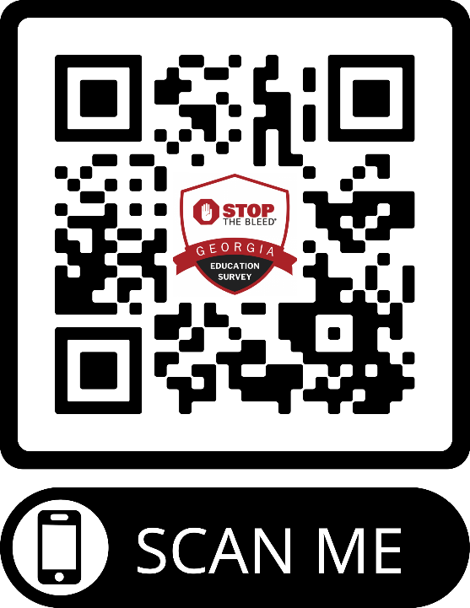
IMPORTANT SURVEY!:
Georgia STOP THE BLEED®
Education Survey
Be Sure to Enter the Following…
Program Type:
<<<YOUR PROGRAM TYPE HERE>>>
Program Location:
<<<YOUR PROGRAM LOCATION HERE>>>
Program Number:
<<<ACS STB PROGRAM NUMBER HERE>>>
https://www.surveymonkey.com/r/GASTOPTHEBLEED
Notes:
Use this slide for the following course types:
STOP THE BLEED® Course – Traditional In-Person Course
STOP THE BLEED® Lecture Only – Virtual Course
STOP THE BLEED® Skills Only – In-person Course
STOP THE BLEED® Skills Only – Virtual Course
STOP THE BLEED® Refresher Course w/ Hands-on Skills Training
STOP THE BLEED® Awareness Program w/ Hands-on Skills Training
STOP THE BLEED® Awareness Program In-Person/Virtual/Video Presentation

Slide 7
IMPORTANT SURVEY!:
Georgia STOP THE BLEED®
Education Survey
Be Sure to Enter the Following…
Program Type:
STOP THE BLEED®
Awareness Program – Video Presentation
Program Location:
ONLINE
Program Number:
99999
https://www.surveymonkey.com/r/GASTOPTHEBLEED
Notes:
Use this slide for the following course types
Awareness Program – Video Presentation
Access Video with Instructions:
https://tinyurl.com/GASTBVid
Direct YouTube Link:
https://www.youtube.com/watch?v=QxZhvjnTwG8

Slide 8
IMPORTANT SURVEY!:
Georgia STOP THE BLEED®
Education Survey
Be Sure to Enter the Following…
Program Type:
STOP THE BLEED® Online Interactive Course
Program Location:
ONLINE
Program Number:
00000
https://www.surveymonkey.com/r/GASTOPTHEBLEED
Notes:
Use this slide for the following course types
STOP THE BLEED® Online Interactive Course
Access Video with Instructions:
https://tinyurl.com/GASTBVid
Direct YouTube Link:
https://www.youtube.com/watch?v=QxZhvjnTwG8

Slide 9
IMPORTANT SURVEY!:
Georgia STOP THE BLEED®
Education Survey
Be Sure to Enter the Following…
Program Type:
STOP THE BLEED® Instructor Orientation
Program Location:
ONLINE
Program Number:
55555
https://www.surveymonkey.com/r/GASTOPTHEBLEED
Notes:
Use this slide for the following course types
STOP THE BLEED® Instructor Orientation

Slide 10
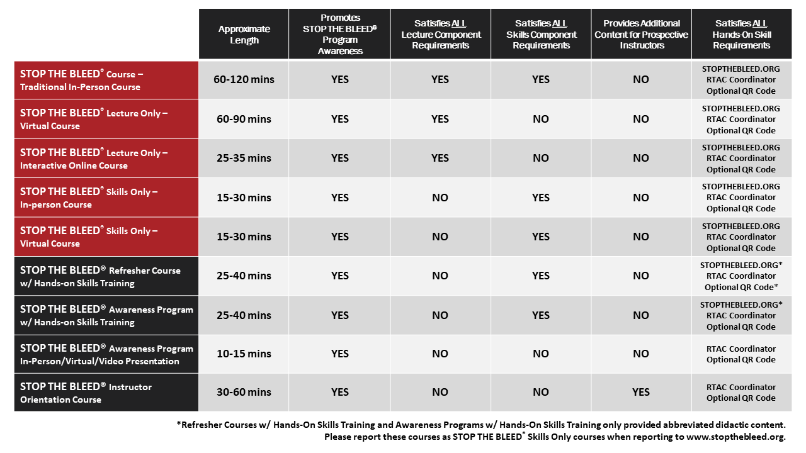
STOP THE BLEED® Course Options
Notes:
This slide provides a quick visual comparison of the various programming options. We will describe these options in more detail on the following slides.

Slide 11
Course Options

Slide 12
Program Delivery Options
American College of Surgeons STOP THE BLEED® Programming:
STOP THE BLEED® Course – Traditional In-Person Course
STOP THE BLEED® Lecture Only – Virtual Course
STOP THE BLEED® Lecture Only – Interactive Online Course
STOP THE BLEED® Skills Only – In-person Course
STOP THE BLEED® Skills Only – Virtual Course
Georgia Specific STOP THE BLEED® Programming:
STOP THE BLEED® Refresher Course w/ Hands-on Skills Training
STOP THE BLEED® Awareness Program w/ Hands-on Skills Training
STOP THE BLEED® Awareness Program In-Person/Virtual/Video Presentation
STOP THE BLEED® Instructor Orientation
Notes:
STOP THE BLEED® Training is more versatile than ever. The Georgia Trauma System uses American College of Surgeons STOP THE BLEED® course materials and instructors should adhere to course guidelines as prescribed in the Instructor portal.
As we review the various course options, keep in mind that participants must complete both the lecture AND the skills component of the STOP THE BLEED® Course to be considered COMPLETE and to receive a certificate of completion.
Georgia programming note. Certificates of program attendance or follow-up email correspondence can serve as verification of LECTURE ONLY or SKILLS ONLY offering attendance. These are provided for attendance verification purposes only and due not signify FULL COURSE completion. DO NOT use the American College of Surgeon’s Course Completion Certificates for this purpose.
American College of Surgeons STOP THE BLEED® Programming:
STOP THE BLEED® Course – Traditional In-Person Course
STOP THE BLEED® Lecture Only – Virtual Course
STOP THE BLEED® Lecture Only – Interactive Online Course
STOP THE BLEED® Skills Only – In-person Course
STOP THE BLEED® Skills Only – Virtual Course
Georgia Specific STOP THE BLEED® Programming:
STOP THE BLEED® Refresher Course w/ Hands-on Skills Training
STOP THE BLEED® Awareness Program w/ Hands-on Skills Training
STOP THE BLEED® Awareness Program In-Person/Virtual/Video Presentation
STOP THE BLEED® Instructor Orientation
Note:
Refresher Courses w/ Hands-On Skills Training and Awareness Programs w/ Hands-On Skills Training only provided abbreviated didactic content. Please report these courses as STOP THE BLEED® Skills Only courses when reporting to www.stopthebleed.org.

Slide 13
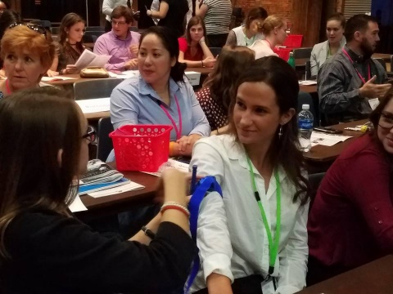
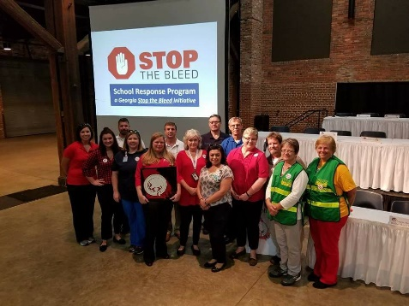
STOP THE BLEED®
Generally, lasts 1 - 2 hours
Traditional in-person course followed by hands on skills practice
8/10 students/instructor
The STOP THE BLEED® presentation is available in the instructor portal.
WWW.STOPTHEBLEED.ORG
Notes:
STOP THE BLEED® Course
The STOP THE BLEED® using live, in-person training to guide participants through the three methods of bleeding control using video demonstrations, interactive learning, and spontaneous quizzes.
The course length varies with audience type, specific needs. The traditional STOP THE BLEED® Course generally lasts 1-2 hours.
Traditional in-person course followed by hands on skills practice Participants complete both the lecture AND the skills components of the STOP THE BLEED® Course.
Instructor Ratio - 8/10 students to 1 instructor.
Content – The STOP THE BLEED® presentation is available in the Instructor Portal at www.stopthebleed.org.
Note: Instructors use training materials specially developed to teach bleeding control techniques. They provide live instruction, guidance, and feedback to students. They are available to check participants movements as they practice three different bleeding control actions. Instructors should keep working with course attendees until they demonstrate the correct skills to STOP THE BLEED® and save a life.
Documentation: Register and “close” courses at www.stopthebleed.org. Maintain your own rosters. Provide general course data to regional STOP THE BLEED® Champion/RTAC Coordinator.

Slide 14

STOP THE BLEED® Virtual Course
Generally, lasts 1 - 1.5 hours
Lecture only course
The STOP THE BLEED® presentation is available in the instructor portal.
Instructor must be present for entire training
WWW.STOPTHEBLEED.ORG
Notes:
The STOP THE BLEED® Course can be presented virtually.
The Virtual Course generally lasts 1 - 1.5 hours
Instructors may present the lecture through a virtual meeting platform utilizing the current presentation or can also elect to use the prerecorded version found in the Instructor Portal.
An instructor must be present through the entire virtual training.
Note: As a reminder, participants must complete both the lecture AND the skills component of the STOP THE BLEED® Course to be considered COMPLETE and to receive a certificate of completion.
Documentation: Register and “close” courses at www.stopthebleed.org. Maintain your own rosters. Provide general course data to regional STOP THE BLEED® Champion/RTAC Coordinator.
*Participation in virtual lecture training will be limited to the maximum number of participants your virtual meeting platform will host, there is not a STOP THE BLEED® Course participant limit to the lecture portion of the virtual course.

Slide 15

STOP THE BLEED® Interactive Course
25-35 minutes
Interactive, online, and on-demand
Video demonstrations, interactive learning, and spontaneous quizzes
Free to all students
Can be taken multiple times
WWW.STOPTHEBLEED.ORG
Notes:
STOP THE BLEED® Interactive Course - New Online Course Available
The STOP THE BLEED® Interactive Course guides participants through the three methods of bleeding control using video demonstrations, interactive learning, and spontaneous quizzes.
TAKE COURSE
Access: www.stopthebleed.org
25-35 minutes
Interactive, online, and on-demand - The interactive course is a virtual alternative to the in-person lecture presentation. The
Video demonstrations, interactive learning, and spontaneous quizzes - Interactive Course guides individuals through the three methods of bleeding control using video demonstrations, interactive learning, and spontaneous quizzes.
Free to all students
Can be taken multiple times - can be taken multiple times to learn and refresh knowledge of the STOP THE BLEED®
Note: While the interactive course fulfills the lecture portion, it does not allow them to receive a certificate of completion until they complete the hands-on skills portion of the course. The interactive course will encourage participants to attend either a full STOP THE BLEED® Course or a Skills-Only STOP THE BLEED® Course to receive their certificate of completion. At the conclusion of the course, they will receive an email with their final quiz results. Participants must show the instructor this document to receive a certificate of completion after they have completed the skills-only portion of the course.
How can viewers access the STOP THE BLEED® Interactive Course and Georgia’s National STOP THE BLEED® Month Education Survey?
To access the course with survey instructions, visit:
https://tinyurl.com/ACSOnlineSTB
To access the course directly, visit:
www.stopthebleed.org

Slide 16
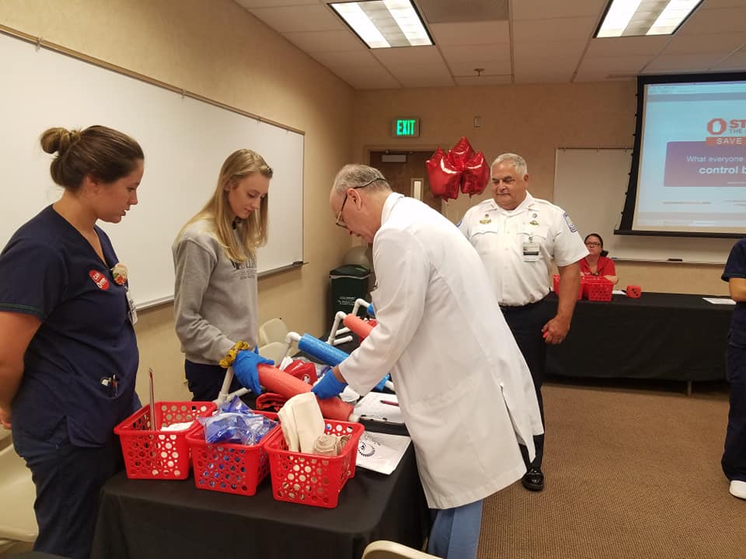
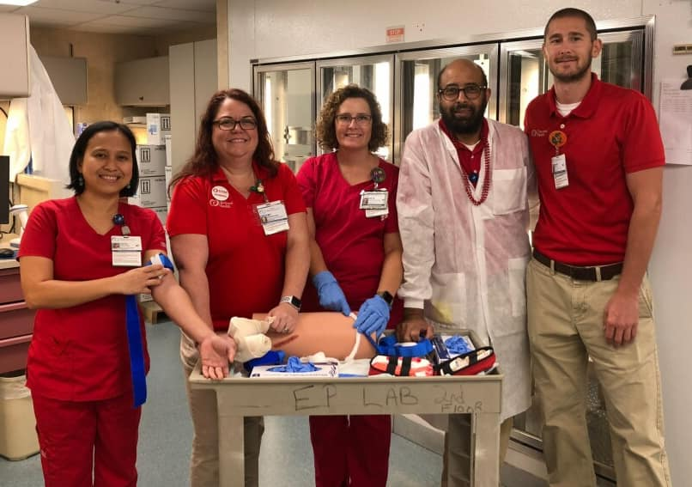
STOP THE BLEED® Skills Only Courses
~15 minutes per student/rotation
Session can be in-person or virtual
1:10 -instructor-to-student ratio
Session demo can be found in the Instructor Portal
WWW.STOPTHEBLEED.ORG
Notes:
The STOP THE BLEED® Skills Only Courses
At the conclusion of the virtual lecture-only courses, participants will require a reminder to schedule the skills portion to complete the STOP THE BLEED® Course requirements.
Instructors can schedule a skills-only training sessions through the Instructor Portal and should indicate if the course is public or private for maximum participation.
~15 minutes per student/rotation – will vary depending on situation. Instructors should keep working with course attendees until they demonstrate the correct skills to STOP THE BLEED® and save a life.
Session can be in-person or virtual – In-person instruction is preferred…especially for those without previous experience.
1:10 -instructor-to-student ratio - Regardless of being in-person or virtual, the STOP THE BLEED® Skills Only Course must meet the 1:10 -instructor-to-student ratio and be reflected in the Instructor Portal properly.
Session demo can be found in the Instructor Portal - Instructors should review the virtual instructor skills video as a guide on how to train the skills-only portion of the course.
Note: As a reminder, participants must complete both the lecture AND the skills component of the STOP THE BLEED® Course to be considered COMPLETE and to receive a certificate of completion.
Documentation: Register and “close” courses at www.stopthebleed.org. Maintain your own rosters. Provide general course data to regional STOP THE BLEED® Champion/RTAC Coordinator.

Slide 17
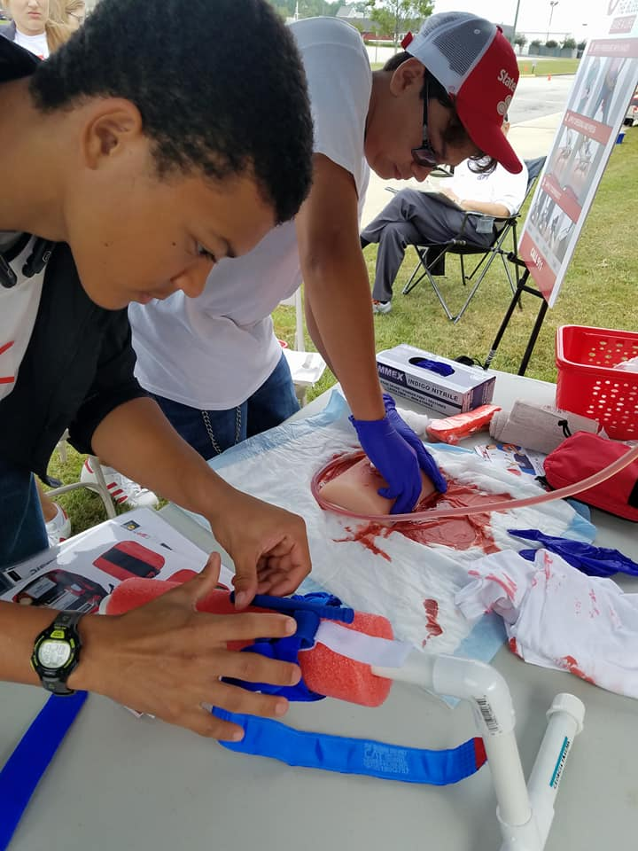
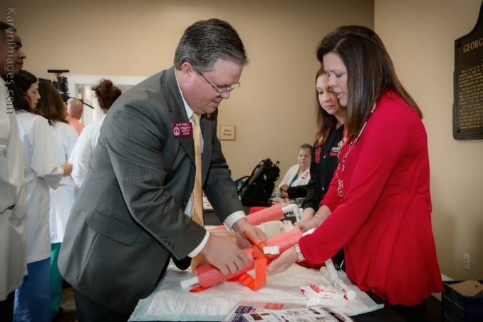
Refresher and Awareness offerings
Abbreviated instruction - designed to offer awareness level training to audiences with time limitations
If including skills instruction and return skills demos by participants - reported as Skills Only courses*
May include video instruction or abbreviated presentations.
*Be sure participants are provided adequate opportunity to practice all associated skills.
Notes:
Refresher and Awareness offerings
Abbreviated instruction - designed to offer awareness level training to audiences with time limitations
If including skills instruction and return skills demos by participants - reported as Skills Only courses*
May include video instruction or abbreviated presentations.
Great for staff meetings, in-services, etc. This is a wonderful opportunity to use the training video developed by the Georgia Trauma Commission.
*Be sure participants are provided adequate opportunity to practice all associated skills.

Slide 18
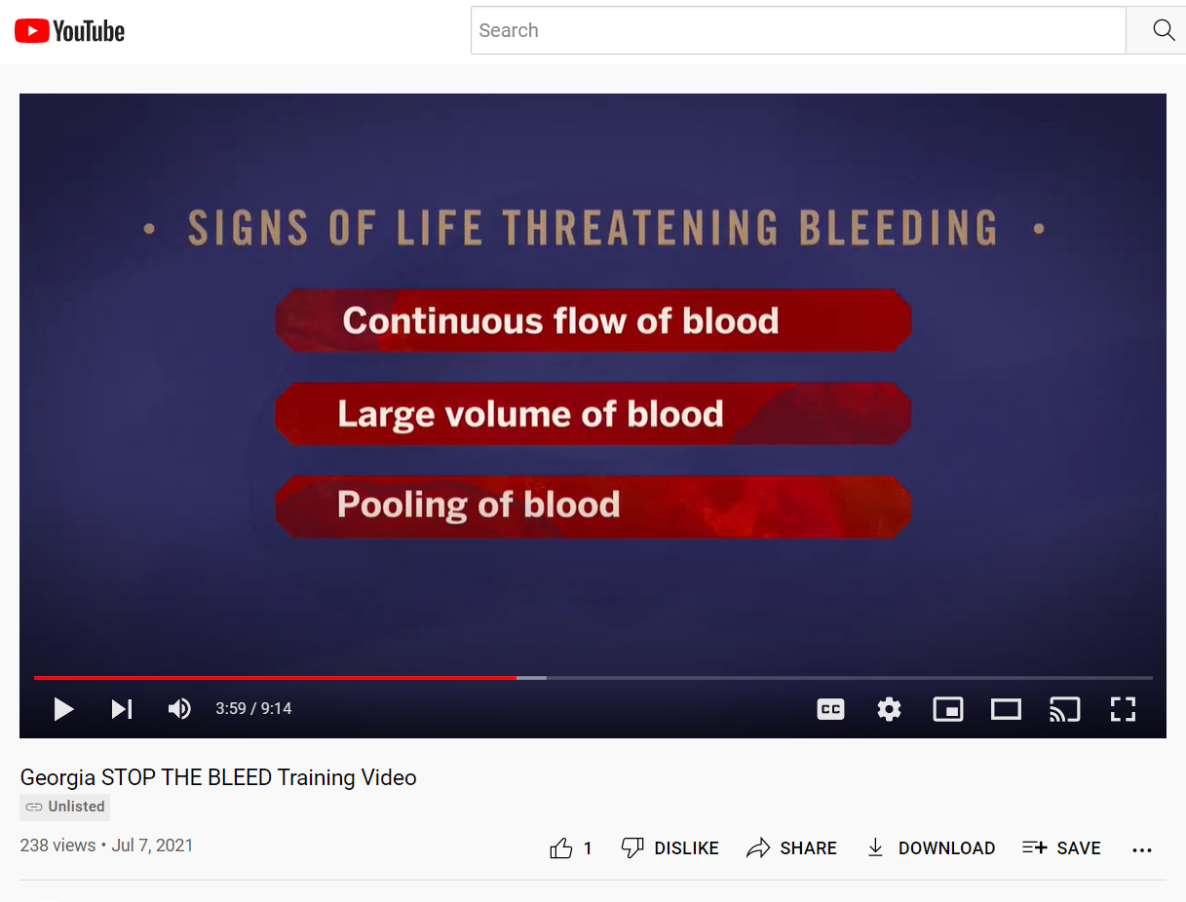
STOP THE BLEED® Awareness Video
Developed by the Georgia Trauma Commission
Designed to offer awareness level training to general audiences
Highlights the key concepts of hemorrhage control for traumatic injury
Notes:
STOP THE BLEED® Awareness Video
May include video instruction or abbreviated presentations.
*Be sure participants are provided adequate opportunity to practice all associated skills.
The Georgia Trauma Commission has developed a short video designed to highlight the key concepts of hemorrhage control for traumatic injury.
Watch this short video to learn more. Then complete our optional survey and you will be entered into our weekly drawing for STOP THE BLEED® Awareness Month Prizes.
How can viewers access the video and the National STOP THE BLEED® Month Education Survey?
To access the video with survey instructions, visit:
https://tinyurl.com/GASTBVid
To access the video via its direct YouTube Link, visit
https://www.youtube.com/watch?v=QxZhvjnTwG8

Slide 19
Final Thoughts

Slide 20

GA STOP THE BLEED® Winter Blitz – Jan 2023
Register all applicable classes in the ACS Instructor Portal
Conduct your STOP THE BLEED® courses
Provide course participants with the optional post-course STB Education survey
Participation Verification Email
Participant Resource Page.
Weekly STB Drawing
Close your course in the ACS Instructor Portal
Report your course specifics to your Region’s STOP THE BLEED® Champion and/or RTAC Coordinator.
WWW.STOPTHEBLEEDGEORGIA.ORG
Notes:
Make sure you are registered as an instructor in the ACS STOP THE BLEED® Instructor Portal at www.stopthebleed.org - There have been recent updates to the instructor eligibility requirements.
Register all applicable classes in the ACS Instructor Portal Conduct your STOP THE BLEED® courses – you are encouraged to train members of your staff and your community.
Provide course participants with the optional post-course STB Education survey.
Participants completing the educational survey will be eligible to be entered into our weekly STOP THE BLEED® Georgia DOOR PRIZE drawings.
Participants completing the educational survey will also receive an email verifying their participation and access to an exclusive STOP THE BLEED® Georgia Participant Resource Page.
Close your course in the ACS Instructor Portal and report your course specifics to your Region’s STOP THE BLEED® Champion and/or RTAC Coordinator.

Slide 21
GA STOP THE BLEED® Instructor Registration
Optional - does not replace ACS Instructor Portal Registration
Allows members of the public to find instructors across Georgia with ease
Only County, Region, Name, Organization, and Email Address are included on list
Allows instructors to receive Georgia specific STOP THE BLEED® notifications
WWW.STOPTHEBLEEDGEORGIA.ORG
Notes:
This Instructor Registration is designed to provide a mechanism for accessing STOP THE BLEED® instructors providing community-based trainings in Georgia. All STOP THE BLEED® instructors are welcome to participate. Instructors can determine whether their information is posted publicly.* This registration is not intended to spam instructors with products and service and discretion will used when sending e-mail to the participating instructors based on this list. You can change our update this information by resubmitting your information. *The listing of STOP THE BLEED® instructors will be at least once each quarter. This Instructor Registration is provided as a resource and a courtesy, we do not validate email addresses.

Slide 22
GA STOP THE BLEED® Instructor Registration
How does it work?
Members of the public making STOP THE BLEED® Course requests are directed to the Local Instructors first.
If no local instructors are available, they are then connected with their regional STOP THE BLEED® Champion
WWW.STOPTHEBLEEDGEORGIA.ORG
Notes:
GA STOP THE BLEED® Instructor Registration
How does it work?
Members of the public making STOP THE BLEED® Course requests are directed to the Local Instructors first.
If no local instructors are available, they are then connected with their regional STOP THE BLEED® Champion
WWW.STOPTHEBLEEDGEORGIA.ORG
Direct link: STOP THE BLEED® Georgia Survey
This instructor list is designed to provide a mechanism for accessing STOP THE BLEED® instructors providing community-based training in Georgia.
All STOP THE BLEED® instructors are welcome to participate.
Instructors can determine whether their information is shared publicly.
The listing of STOP THE BLEED® instructors is updated at least once quarterly.
This instructor list is provided as a resource and a courtesy – we do not validate email addresses.
STOP THE BLEED® Georgia is not a credentialing organization or regulatory agency.

Slide 23
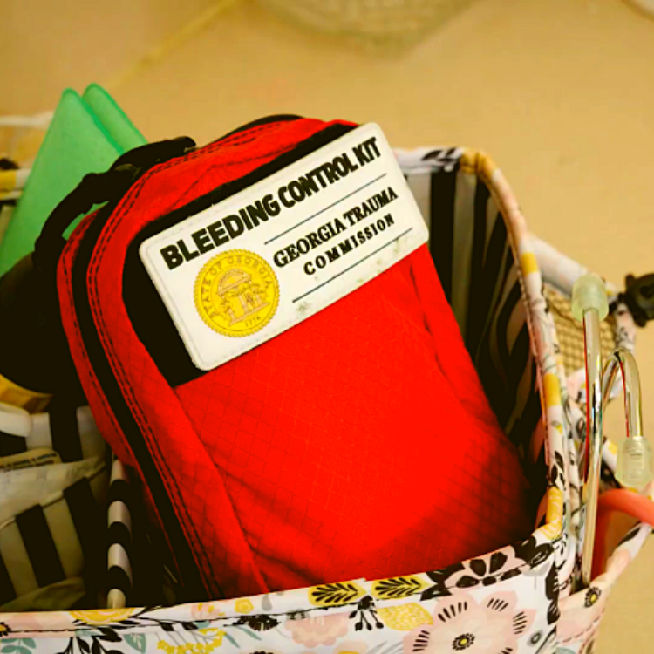
“Georgia Kit”
North American Rescue Cost per kit: $39.98 Item #: 85-1563 Phone: 888.689.6277 Email: info@NARescue.com
Notes:
Bleeding Control Kits like the ones we use in training can be purchased from a number of vendors and are also available at www.stopthebleed.org and www.stopthebleedcoalition.org.
The small Bleeding Control Kits or “Georgia Kits” being provided to public schools state-wide by the Georgia Trauma Commission are being made by North American Rescue. ANY agency, institution, business or individual may contact customer service at North American Rescue (1-888-689-6277) and request a quote OR order the “Georgia” kit(s) using item number 85-1563. Currently, the price for GEORGIA RESIDENTS purchasing the GEORGIA KIT is $39.98 per kit.
Note: The Georgia Kit cannot be ordered online. North American Rescue will need to be contacted directly to request a quote or place an order.
Option 1: Please call Joi Ferguson at 864-675-9800 ext 246 to order your kit(s). If you would like a quote, please email her at JFerguson@narescue.com with the following information:
Name:
Billing Street Address:
City:
State:
Zip Code:
Phone Number:
Please advise if you have created an account using a personal email address, please provide the email address for verification purposes.
Option 2: If you are unable to reach her please call 864-675-9800 and anyone will be happy to assist you.
If I can be of any further assistance, please do not hesitate to let me know.
Also, we DO NOT sell Georgia Kits, nor to we make money from the sale of the Georgia Kits. In general, STOP THE BLEED® instructors are poor.

Slide 24
IMPORTANT SURVEY!:
Georgia STOP THE BLEED®
Education Survey
Be Sure to Enter the Following…
Program Type:
STOP THE BLEED® Instructor Orientation
Program Location:
ONLINE
Program Number:
55552
https://www.surveymonkey.com/r/GASTOPTHEBLEED
Notes:
Use this slide for the following course types
STOP THE BLEED® Instructor Orientation

