Slide 1





Notes:
Georgia Specific Slide
Note to instructor: Other following introductory slides are specific to Georgia’s STOP THE BLEED® initiatives. We’ve included a number of optional (“hidden”) slides to assist you with your presentation.
The Georgia’s STOP THE BLEED® initiatives are the joint effort of the Georgia Trauma Commission, Georgia Trauma Foundation, Georgia Committee on Trauma, the Georgia Society of the American College of Surgeons, and many other Georgia Trauma System partners.

Slide 2
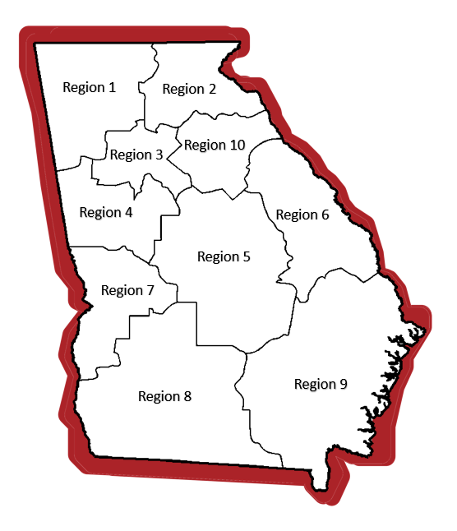

Introductions:
Jaina Carnes
Wellstar North Fulton Hospital
Region 3
Kimberly Coleman
Central Georgia Technical College
Region 5
Dr. Lindsay Riedl Jaeger
Children’s Healthcare of Atlanta – Egelston
Region 3
Kristal Smith
Atrium Health Navicent Medical Center
Region 5
Notes:
Georgia Specific Slide
Note to instructor: Optional Slide – To utilize, update with presenter(s) information and right click on slide icon to the left to unhide.

Slide 3
Special Thanks To:
Georgia Committee on Trauma Excellence
Georgia Department of Education
Georgia Department of Public Health
Georgia Emergency Management and Homeland Security Agency
Georgia Emergency Medical Services Association
Georgia Hospital Association
Georgia Office of EMS and Trauma
Georgia Public Safety Educators Association
Georgia Regional Trauma Advisory Committees (RTACs)
Georgia Society of the American College of Surgeons
Georgia Trauma Commission
Georgia Trauma Foundation
All of Our Awesome Volunteers!
Notes:
Georgia Stop the Bleed Blitz Specific Slide
Note to instructor:
These are some of our principal partners.

Slide 4
Program Highlights
STOP THE BLEED® is designed to enable you to render immediate, potentially life-saving medical aid to the injured while you await the arrival of professional responders.
Ordinary People + Simple Actions
= Lives Saved
Notes:
Georgia Specific Slide
Note to instructor: Program Highlights - The STOP THE BLEED® is designed to enable you to render immediate, potentially life-saving medical aid to injured students or co-workers while you await the arrival of professional responders.
The program is based on the premise that ordinary people, using simple actions, save lives.

Slide 5
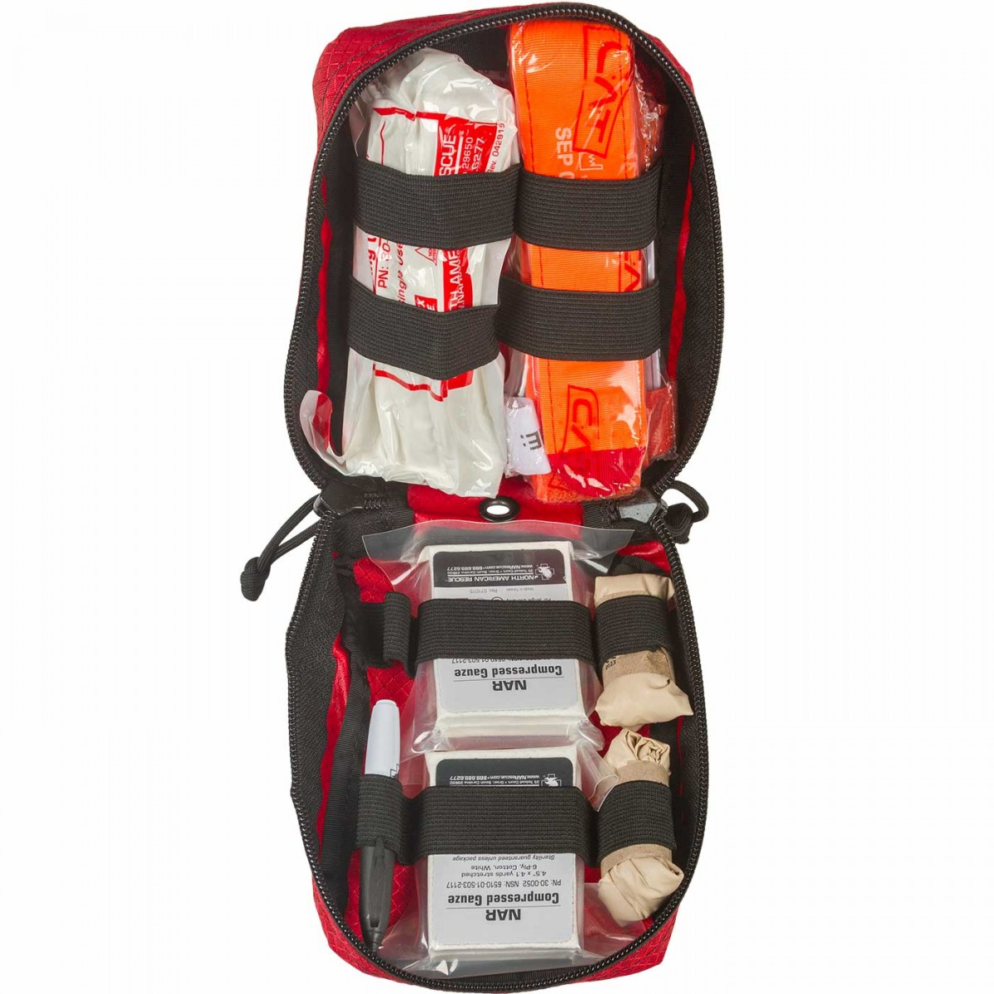
Bleeding Control Kit Components
2 – Pair of Nitrile Gloves
1 – C-A-T Tourniquet
2 – Compressed Gauze
1 – 6” Emergency Trauma Dressing
1 – Trauma Shears
1 – 5”x9” Trauma Pad
1 – 2” Roll of Tape
1 – Permanent Marker
1 – English/Spanish Instruction Card
Notes:
Georgia Specific Slide
Note to instructor: Time permitting, stop “sharing” the presentation long enough to show participants each of the Bleeding Control Kit’s components.
Bleeding Control Kit Components
Nitrile Gloves (2 pair)
C-A-T Tourniquet
Compressed Gauze (x2)
6” Emergency Trauma Dressing
Trauma Shears
5”x9” Trauma Pad
Tape
English/Spanish Instructions
Important: While we DO NOT sell Bleeding Control Kits, we will be able to provide specifics on how to purchase the Georgia Kit.

Slide 6



STOP THE BLEED® Course
American College of Surgeons
SAVE A LIFE
Copyright © 2019 American College of Surgeons
Version 2
BLEEDINGCONTROL.ORG
STOPTHEBLEED.ORG
STOP THE BLEED® is a registered trademark of the U.S. Department of Defense
Notes:
STOP THE BLEED® is a national campaign with a goal to save lives by training people across the country how to stop life threatening bleeding.
The Georgia Trauma System uses the STOP THE BLEED® Course Developed by the American College of Surgeons.

Slide 7
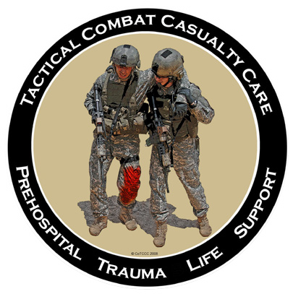




The American
College of Surgeons Committee on Trauma
The American
College of Emergency Physicians
The National Association of
Emergency Medical Technicians
The Committee on Tactical Combat Casualty Care
Notes:
This educational program represents the joint effort of many organizations.
Today we will discuss the current “best practice” recommendations for how to manage life-threatening bleeding.

Slide 8
WARNING! Some of the images shown during this presentation are graphic and may be disturbing to some people.
Notes:
This course was designed to teach you how to recognize and control life-threatening hemorrhage. We cannot do that without clinical photographs that are relevant to the course content. Some of these photographs are graphic in nature and may be disturbing to some individuals.
The lay-public course does not have graphic clinical photos, but this slide allows you to speak to bleeding emergencies can be graphic and the immediate responder will see a lot of blood. Managing their expectations regarding a bleeding emergency can be discussed.

Slide 9
Why Do I Need This Training?
The #1 cause of preventable death
after injury is bleeding.
Notes:
If time is sufficient and only a small group of participants, ask class why they are taking the course.
Bleeding is the most common cause of preventable death after injury and must be stopped as soon as possible.

Slide 10




Where Can I Use This Training?
Notes:
Many injury mechanisms can result in serious bleeding.
Stress that while mass shootings currently receives a lot of attention, serious bleeding is more likely to result from everyday injuries such as those that may occur at home, at work or while on the road.
The techniques being taught in this course apply to bleeding regardless of the cause.
Consider using one or two examples where they may encounter life-threatening bleeding such as during a sporting event or around broken glass at home.

Slide 11
Goals
1. Identify
Recognize
life-threatening bleeding
Stop the Bleed
Take steps to
STOP THE BLEEDING
  Pressure
✓ Packing
✓ Tourniquets
Notes:
The focus of this STOP THE BLEED® training is the immediate response to bleeding.
Everyone should know how to recognize life-threatening bleeding.
Everyone should be able to take the appropriate steps to control bleeding until help arrives.
If you do not feel comfortable with controlling bleeding, you can still help by calling 911 and assisting others who are controlling bleeding.
By the end of today’s presentation, you should be able to identify life-threatening bleeding and know what steps to take to Stop the Bleeding.
We will focus on three strategies to control bleeding.
They are direct pressure, wound packing, and use of tourniquets.

Slide 12
Personal Safety
YOUR safety is YOUR first priority
If you are injured, you cannot help others
Help others only when it’s safe to do so
If the situation changes or becomes unsafe:
✓ Stop
✓ Move to safety
✓ If you can, take the victim with you
Notes:
Let’s discuss the primary principles that you will need to know in a bleeding emergency,
Before you can help an injured person, you must first take steps to make sure you are safe.
YOUR safety is YOUR first priority
If you become injured as well, you won’t be able to help anyone and you will become a victim, the situation you find yourself in becomes more complicated.
If the scene in not safe for whatever reason, you should remove yourself (and the victim, if possible) from danger and try to find a safe location.

Slide 13
Personal Safety
YOUR safety is YOUR first priority
Wear gloves if you can
If you get blood on you, be sure to clean any part of your body that the blood has touched
Tell a health care provider that you got blood on you, and follow his or her direction
Notes:
Stress the importance of personal protective equipment and avoiding contact with blood and body fluids.
Wear gloves if you can
If you get blood on you, be sure to clean any part of your body that the blood has touched
Tell a health care provider that you got blood on you, and follow his or her direction
While the risk of transmission is extremely low, it is not zero.
Avoid direct contact with blood or body fluids on your skin, eyes, or mouth
Wash hands after any contact even if no visible blood

Slide 14
ABCs of Bleeding Control
A Alert 911
B Bleeding
C Compress
Notes:
Once you reach safety, you can focus on bleeding control and utilize the ABC’s of bleeding.

Slide 15
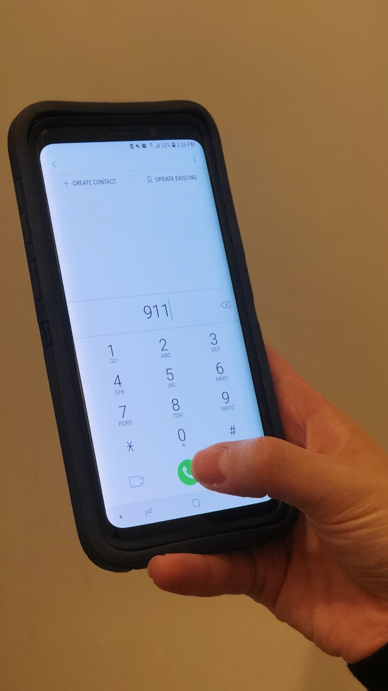
ABCs of Bleeding Control
A Alert 911
B Bleeding
C Compress
Notes:
The ABC’s of bleeding starts with alerting professional responders by calling 911.

Slide 16
ABCs of Bleeding Control
A Alert 911
Call 911
Know your location
Follow instructions provided by 911 operator
Notes:
Alerting 9-1-1 early is extremely important and will assure that the appropriate professional emergency responders will arrive as quickly as possible.
The 911 dispatcher will guide you through the conversation.
What happened?
When did it occur?
Where are you?
Number and status of victims?
Ongoing threats to your safety?
Note* (Can be explained to the participant if necessary) When you make a 911 call on a mobile phone, you must know your location and if you are using a cell phone, the call back number.
If the situation and your battery power allows, you, or someone, should stay on the line.

Slide 17
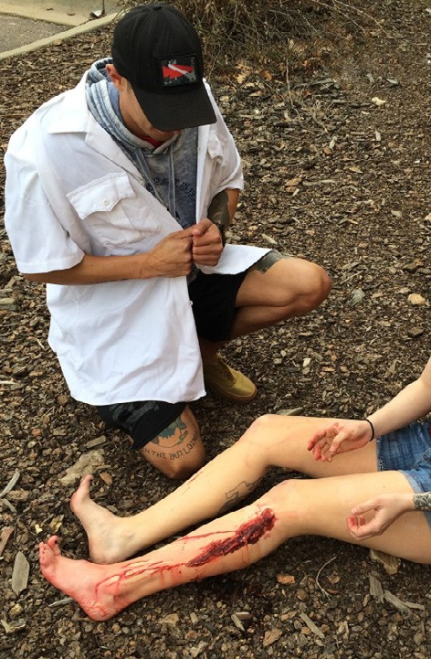
ABCs of Bleeding Control
A Alert 911
B Bleeding
C Compress
Notes:
After alerting 9-1-1, find where the bleeding is coming from. Open or remove clothing when possible so that you can see the wound. Look for and identify life-threatening bleeding.

Slide 18
ABCs of Bleeding Control
B Bleeding
Find source of bleeding
Look for:
  Continuous bleeding
  Large-volume bleeding
  Pooling of blood
Notes:
Life threatening bleeding is often a question of pressure and/or volume.
Meaning, life threatening bleeding is 1- large volume bleeding that is continuous, 2- large volume, pulsatile, like a sprinkler, or 3- is enough to pool in clothing or on the ground.
The faster we can control the bleeding the better the patient will do.

Slide 19
ABCs of Bleeding Control
B Bleeding
There may be multiple places the victim is bleeding
Clothing may also hide
life-threatening bleeding
Notes:
Even if you find one source of bleeding, there may be others
There may be multiple places the victim is bleeding
Clothing may also hide life-threatening bleeding
Be sure careful to identify all sources of serious bleeding

Slide 20
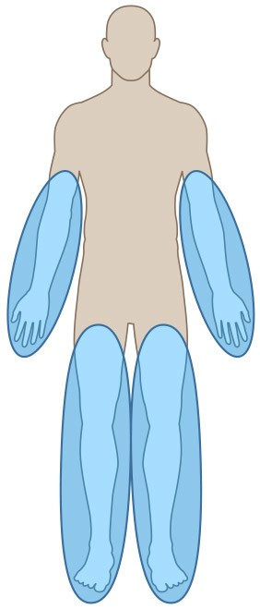
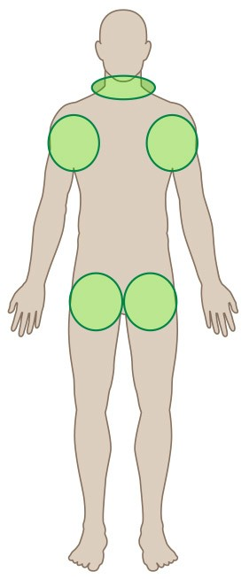
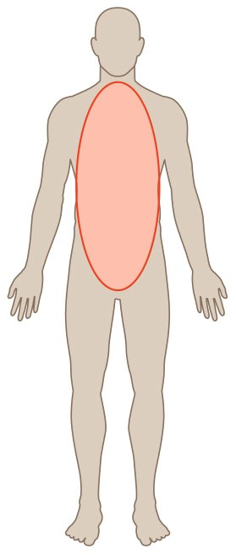
ABCs of Bleeding Control
B Bleeding
Arms and legs
Neck, armpits,
and groin
Body
Notes:
The principles being taught in this course apply to external bleeding.
This can occur from the extremities (blue) and from the junctional areas (green) which consist of the neck, armpits and groin.
Junctional bleeding can be severe as large caliber blood vessels run through these areas.
The third location where there can be bleeding is the body (red).
Often, this internal bleeding into the body cannot be controlled in the field and requires rapid transportation to a hospital or trauma center.

Slide 21
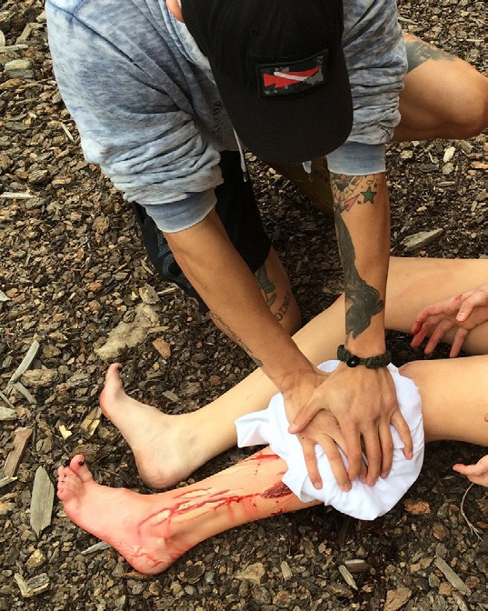
ABCs of Bleeding Control
A Alert 911 B Bleeding
C Compress - Pressure
Notes:
Now that we’ve discussed how to recognize life-threatening bleeding and the location of wounds that can cause death due to bleeding, let’s talk about how to stop the bleeding.

Slide 22
ABCs of Bleeding Control
C Compress - Pressure
Apply direct pressure to wound
Focus on the location of the bleeding
Use just enough gauze or cloth to cover injury
If pressure stops the bleeding, keep pressure on wound until help arrives
Notes:
Pressure will stop the majority of bleeding.
Start with pressure, use a small amount of gauze or material, just enough to cover the wound. Excess gauze or material makes pressure ineffective. If gauze is unavailable, use any clean material.
Apply pressure directly to the bleeding site.
The application of pressure may require a significant amount of force. Apply enough force to stop the bleeding and continue applying this pressure until help arrives.

Slide 23
STB-Clip-Direct-Pressure-Slide 23
Notes:
Georgia Specific Slide
Note to instructor:
Click to play video.

Slide 24
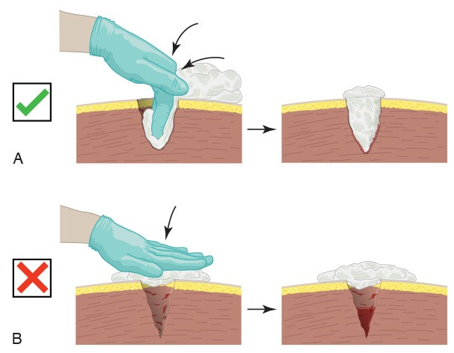
ABCs of Bleeding Control
C Compress - Packing
For large wounds, superficial
pressure is not effective
If bleeding is from a deep wound, pack gauze tightly into the wound until it stops the bleeding; hold pressure until help arrives
Notes:
If bleeding is from a cavity and/or a large wound, superficial pressure may not work and you may need to pack the wound deeply and tightly. Be careful as there may be sharp objects or fragments of bone within the cavity. Once the bleeding stops, do not check the wound, simply hold pressure until help arrives.

Slide 25
STB-Clips-Wound-Packing-Slide 25
Notes:
Georgia Specific Slide
Note to instructor:
Click to play video.

Slide 26
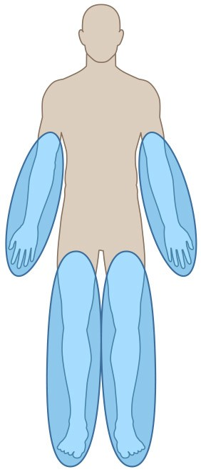
ABCs of Bleeding Control
C Compress - Packing
Arms and legs
Neck, armpits,
and groin
Body
Notes:
Wound packing is appropriate for the arms and legs when wound are large or deep and a tourniquet is not immediately available.
Wound packing is appropriate for wound to the armpits, groin, or sides of the neck when superficial pressure is not enough to stop the bleeding.
Do not pack wounds to the torso (chest, abdomen, or back. Remember, this is often internal bleeding into the body cannot be controlled in the field and requires rapid transportation to a hospital or trauma center.

Slide 27
ABCs of Bleeding Control
C Compress - Tourniquet
Apply 2 to 3 inches above wound
Do not place over the elbow or knee
Tighten tourniquet until bleeding stops
Do NOT remove the tourniquet
Notes:
So let’s talk about tourniquets. Tourniquets are devices that put pressure on blood vessels above the site of a serious wound to stop on-going bleeding. If applied correctly, a tourniquet will stop the flow of blood to the extremity and out of the wound that will limit blood loss and hopefully prevent that patient from going into shock, or in worse cases, from dying.
Tourniquets should be considered for extremity bleeding that does not stop with pressure or packing, or if the situation does not allow you to maintain pressure on the wound.
Tourniquets should be considered for extremity bleeding that does not stop with pressure or packing, or, the situation does not allow you to maintain pressure on the wound.
Questions usually are asked about amputations and should you immediately use a tourniquet. You can defer making the following points if the questions don’t come up and time is an issue.
Using one of the recommended tourniquets is a safe procedure.
No amputations have been caused by a tourniquet when left in place for fewer than two hours
BUT… it is best to get the patient to a trauma center as soon as possible so the bleeding can be completely controlled, and the tourniquet removed
If it comes down to a choice between someone bleeding to death and the risk of damage to the arm or the leg, it is better to use a tourniquet and risk the damage to the arm or leg than to have them bleed to death.

Slide 28
ABCs of Bleeding Control
C Compress - Tourniquet
Can apply to others or on yourself
Can be applied over clothes
Tourniquets HURT
A second tourniquet may be required to stop the bleeding

Slide 29
STB-Clip-Tourniquet-Slide 29
Notes:
Georgia Specific Slide
Note to instructor:
Click to play video.

Slide 30
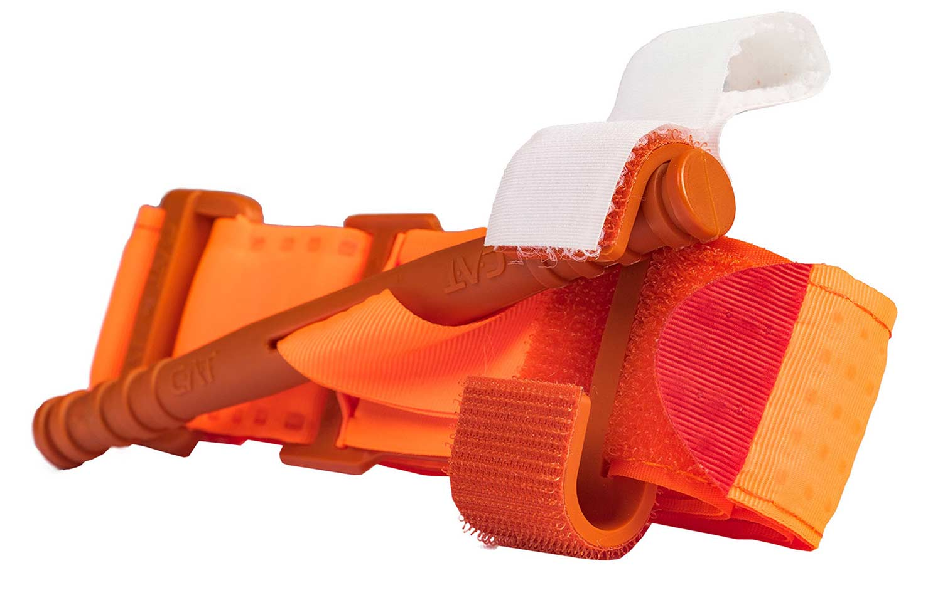
ABCs of Bleeding Control
CAT
Windlass Strap
Self-Adhering band
Windlass Rod
Windlass Clip
Notes:
Georgia Specific Slide
Note to instructor:
The Bleeding Control Kits being distributed by the Georgia Trauma Commission and partnering agencies include a Combat Application Tourniquet Gen 7 (CAT). tourniquet. The (CAT) tourniquet is the military’s preferred tourniquet because it is easy to use and can be rapidly applied.
This tourniquet has a self-adhering (Velcro type) band and a buckle to fit a wide range of extremities. It uses a windlass rod to tighten the tourniquet and a windless clip and strap to secure the rod.

Slide 31
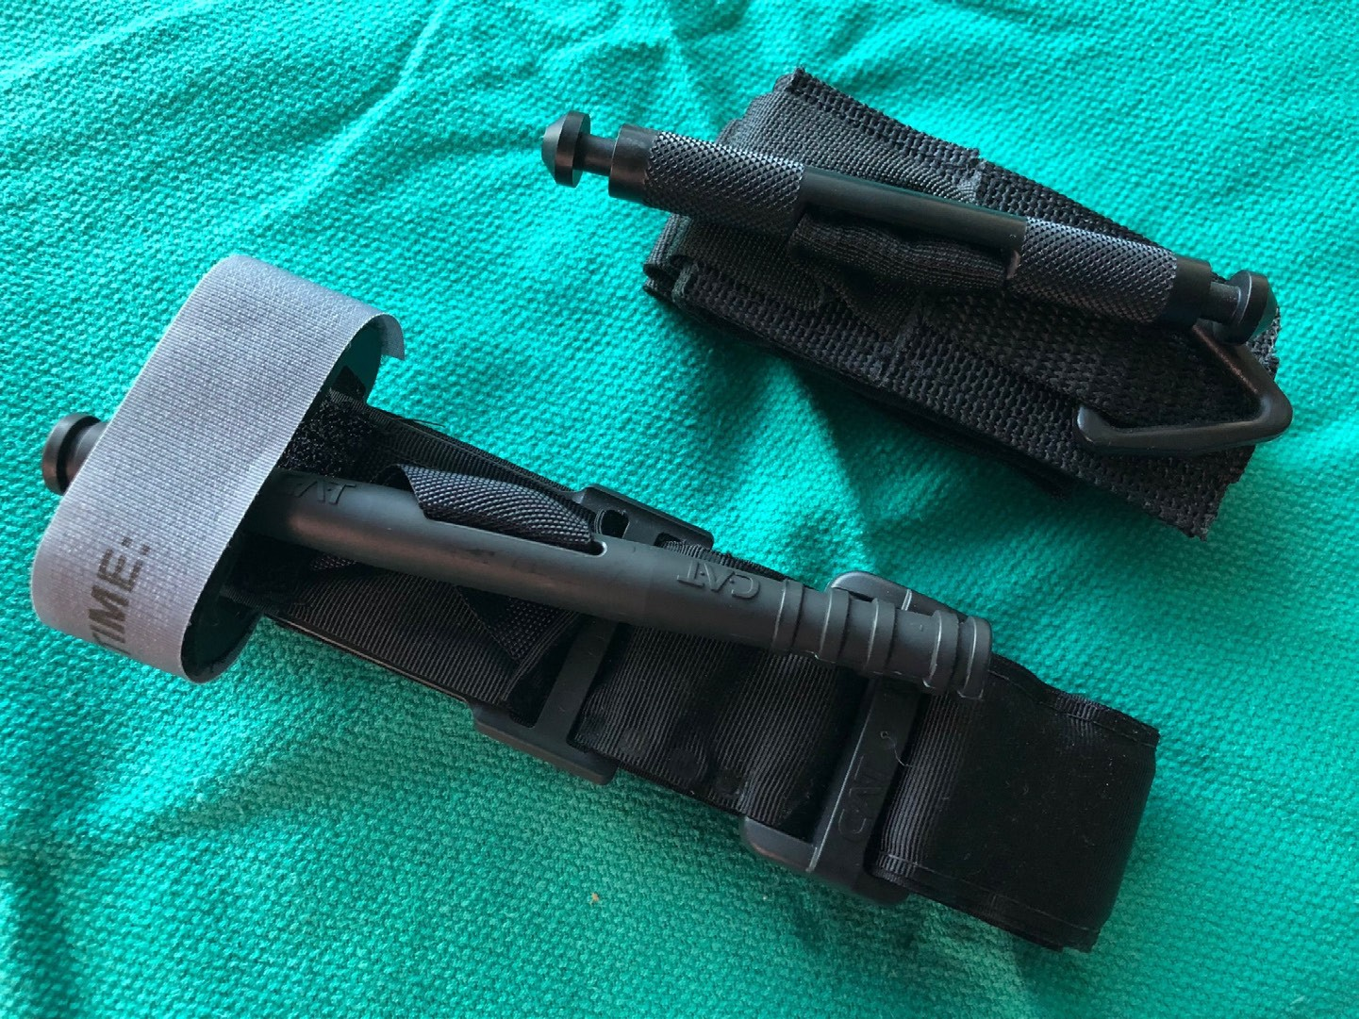
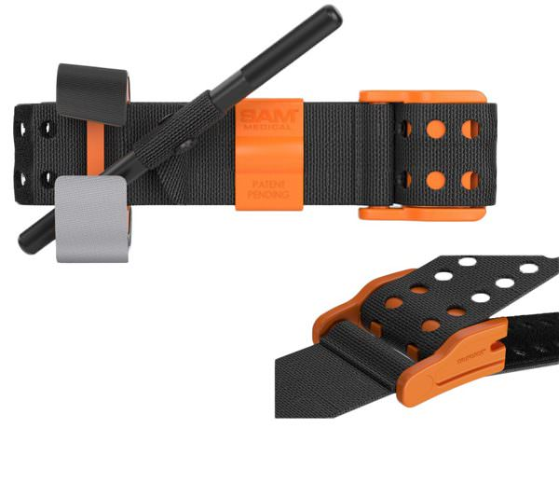
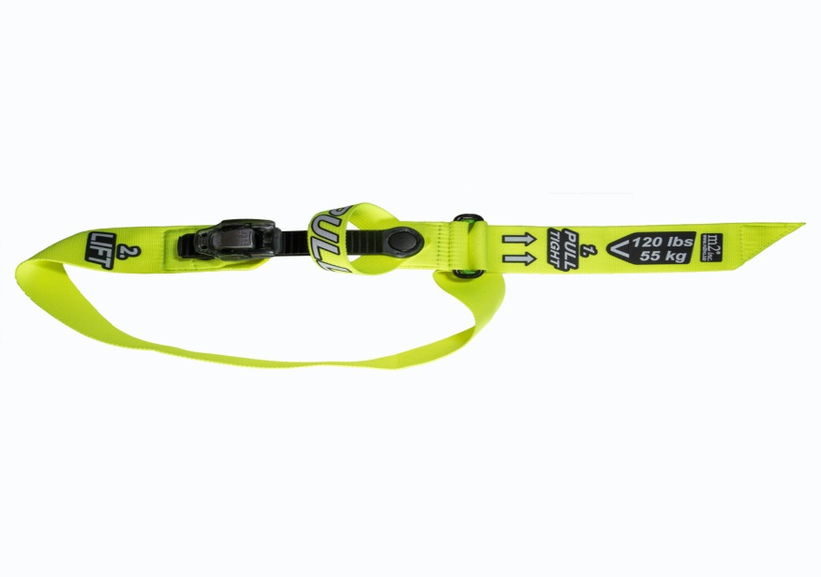
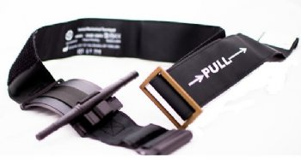
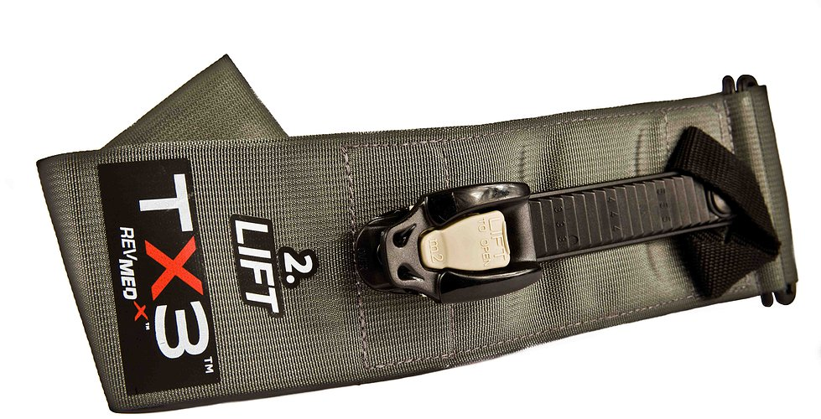
ABCs of Bleeding Control
SOFT-TT
CAT
RMT
SAM-XT
CAT
TX3
TMT
Notes:
There are many types of commercially available tourniquets.
The types tourniquets shown here have been studied by the U.S. Army Institute for Surgical Research and have been shown to consistently work the best.
While other tourniquets are available and may be less expensive, these tourniquets have been carefully evaluated and shown to be effective.
The Committee on Tactical Combat Casualty Care also known as CoTCCC or TCCC is the resource the Committee on Trauma STOP THE BLEED® Program utilizes for direction regarding equipment.
This slide depicts tourniquets that are approved and listed on the TCCC’s adjunct formulary, however not every version of the approved tourniquet is shown. The next slide, Slide 26, provides a by name list of tourniquets approved through TCCC.
It is important to stress that improvised tourniquets are difficult to make and to apply correctly and may in fact increase the bleeding by compressing the venous structures. Their utility has not been scientifically proven and therefore caution should be used when considering their use.

Slide 32
CoTCCC Recommended STB Tourniquets
Recommended Non-Pneumatic Limb Tourniquets
Combat Application Tourniquet Gen 6 (CAT-6)
Combat Application Tourniquet Gen 7 (CAT-7)
Ratcheting Medical Tourniquet (RMT) Tactical
SAM Extremity Tourniquet (SAM-XT)
SOF Tactical Tourniquet–Wide (SOFTT-Wide)
Tactical Mechanical Tourniquet (TMT)
TX2 Tourniquet (TX2)
TX3 Tourniquet (TX3)
Notes:
https://www.deployedmedicine.com/market/11/content/100
Slide 26, provides a by name list of tourniquets approved through TCCC.

Slide 33
FAQs
In all but the extremely young child, the same tourniquet used for adults can be used in children.
For the infant or very small child (tourniquet too big), direct pressure on the wound as described previously will work in virtually all cases.
For large, deep wounds, wound packing can be performed in children just as in adults using the same technique as described previously.
Notes:
Techniques to control bleeding in the child are very similar to what has been presented for adults.
As long as they can be properly applied, the same tourniquet can be used in an adult or a child.
If the child is too small for the tourniquet to be applied properly, direct pressure on the bleeding wound will almost always work to control the bleeding.
Wound packing is the same in both adults and children.

Slide 34
FAQs
Impaled objects?
Improvised tourniquets?
Loss of arm or leg?
Pain?
Other questions?
Notes:
These are common concerns. Take the time to review these carefully with your students.
Impaled objects should be left in place and not removed. The immediate responder could apply a tourniquet above the object. Professional medical personnel, Fire and EMS, are trained to treat impaled objects.
Improvised tourniquets – It is important to stress that improvised tourniquets are difficult to make and to apply correctly and may in fact increase the bleeding by compressing the venous structures. Their utility has not been scientifically proven and therefore caution should be used when considering their use.
Loss of arm or leg is referring to the fear that a tourniquet could result in the victim losing their arm or leg if the immediate responder places a tourniquet on the victim. Reassure them that placing a tourniquet on a victim will save their life and far outweighs the loss of an extremity. There are studies available regarding length of time of tourniquet placement.
Victims will experience pain with direct pressure, wound packing, and tourniquet application. It is important to manage their expectations regarding all three techniques for controlling bleeding.
Other questions can and will be asked, please note questions and send unique questions or questions that you cannot answer to STB staff to provide a response for you and for future course updates.

Slide 35
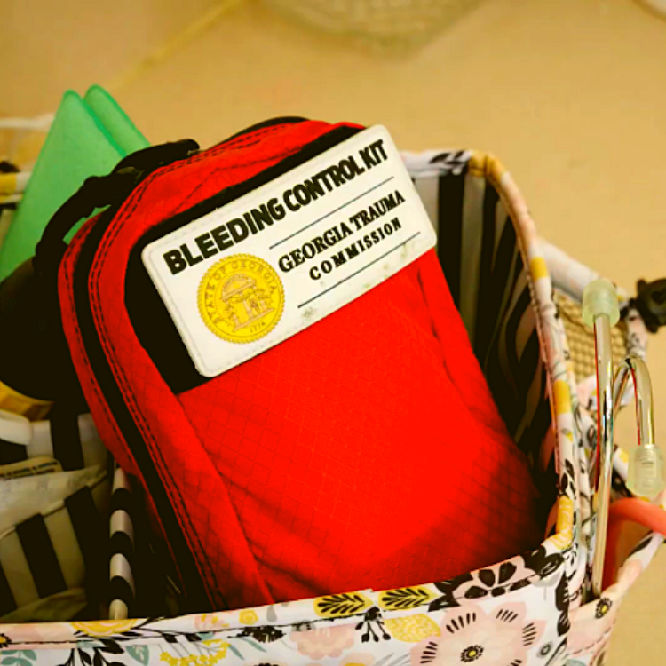
FAQs
      “Georgia Kit”
      North American Rescue
      Cost per kit: $49.98
      Item #: 85-1563
      Phone: 888.689.6277
      Email: info@NARescue.com
Notes:
Bleeding Control Kits like the ones we use in training can be purchased from a number of vendors and are also available at www.stopthebleed.org and www.stopthebleedcoalition.org.
The small Bleeding Control Kits or “Georgia Kits” being provided to public schools state-wide by the Georgia Trauma Commission are being made by North American Rescue. ANY agency, institution, business or individual may contact customer service at North American Rescue (1-888-689-6277) and request a quote OR order the “Georgia” kit(s) using item number 85-1563. Currently, the price for GEORGIA RESIDENTS purchasing the GEORGIA KIT is $39.98 per kit.
Note: The Georgia Kit cannot be ordered only. North American Rescue will need to be contacted directly to request a quote or place an order.
Also, we DO NOT sell Georgia Kits, nor to we make money from the sale of the Georgia Kits. In general, STOP THE BLEED® instructors are poor.

Slide 36

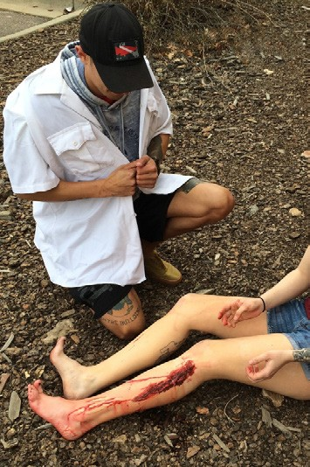
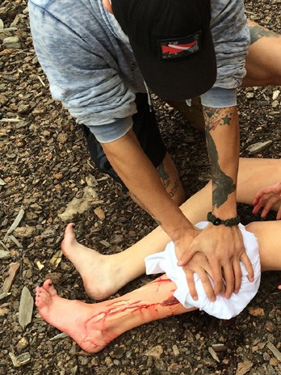
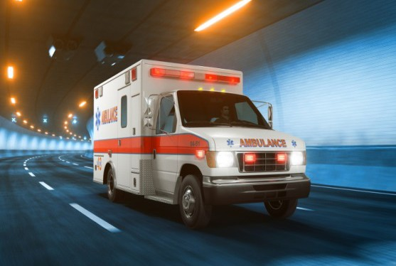
Summary
Personal safety A Alert 911
B Find bleeding C Compress with
pressure and/or packing
C Compress with a tourniquet
Wait for help to arrive
Notes:
Briefly summarize key points.
Note: The Georgia specific video on the following also provides a summary.

Slide 37
STB-Clip-Summary-Slide 37
Notes:
Georgia Specific Slide
Note to instructor:
Click to play video.

Slide 38
The only thing more tragic than a death… is a death that could have been prevented.
Notes:
The only thing more tragic than a death… is a death that could have been prevented.
Express your appreciation for everyone's attendance and for the service that they provide to Georgia’s children.
Encourage participants to visit stopthebleed.org or stopthebleedgeorgia for more information on STOP THE BLEED®.

Slide 39
IMPORTANT SURVEY!:
The survey tool on the NEXT slide will be used to document attendance and for
completion of the optional
post course survey.
The survey entries will be used for our door prize drawing.
Notes:
Georgia Specific Slide
Note to instructor:
The survey tool on the following slide will be used to document attendance and for completion of the optional post course survey.

Slide 40
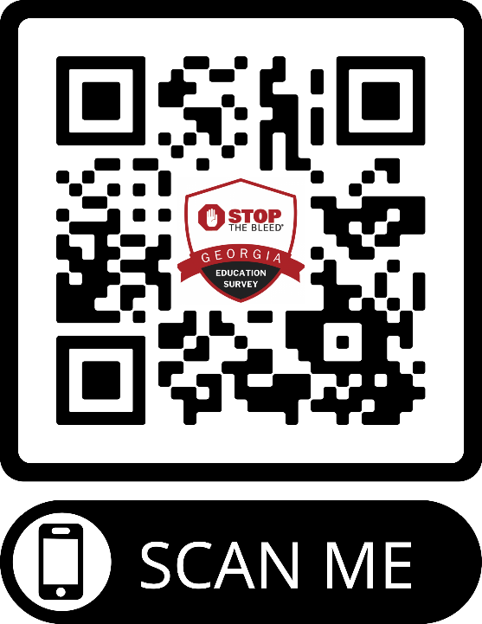
STOP THE BLEED® Georgia
Education Survey
Complete the survey
for Your chance to win
a Bleeding Control Kit
https://www.surveymonkey.com/r/GASTOPTHEBLEED

